Slide 1
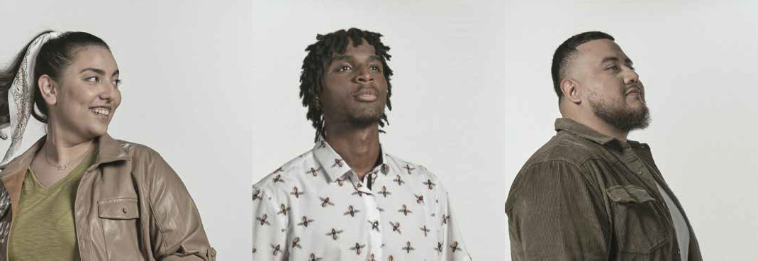








Thank You for Helping HCC Students Frame Their Futures
2021 Gratitude Report
SHANZA A.
JOSEPH B.
EDUARDO A.

Slide 2
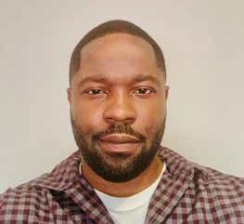
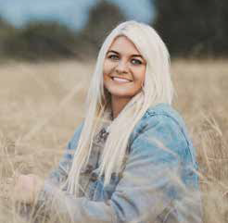
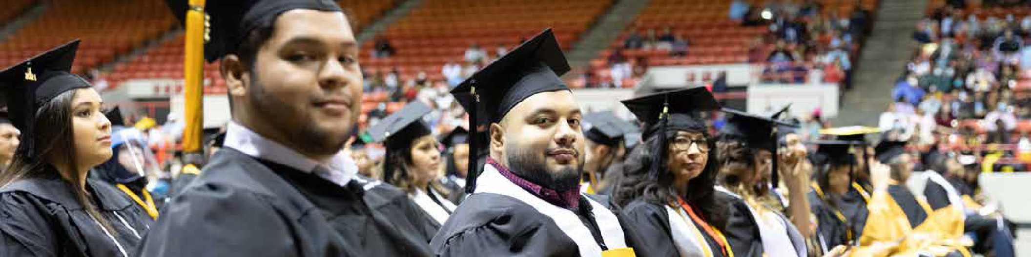
Mission
HCC Foundation empowers
HCC student success through philanthropic support, aligned with key HCC institutional initiatives.
Vision
The HCC Foundation will serve as a
philanthropic force supporting high quality educational experiences for HCC students of all backgrounds to help them improve the trajectory of their lives.
“When I complete my CCNA training, I will be able to put my mom and dad into retirement — something they both deserve more than anything. I want to provide for them and give them anything they want.”
Benneth Akpa
PepsiCo Uplift Scholarship
“With this scholarship, I am able to continue pursuing my career in communication and
journalism for school. It is such an honor to be a recipient of this award.”
Alyssa Freeman
David & Jean Wiley Foundation Scholarship

Slide 3
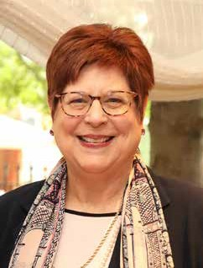

Thank You for Helping HCC Students Frame Their Futures with Your Generous Investment
As President of the HCC Foundation, I always say my favorite activity is to meet our students and the donors whose generosity positively influences the lives of our students on a daily basis. And even
though we haven’t had many opportunities to gather in person in recent times, I am confident you are each smiling with joy like me to read the stories
of our amazing students and see their smiles of confidence.
It is truly a highpoint to celebrate our student scholars and read in their words, what you make possible for them. Thank you for your generosity to help these dreams become a reality. Our scholarship recipients make us all very proud!
The annual HCC Foundation Gratitude Report is opportunity to celebrate our student scholars, and the donors who inspire and invest in Houston’s Future by investing in HCC Students who are Houston’s Future.
Together, we help HCC Students Frame Their Futures by providing the support they need to succeed at HCC.
The impact of our donors’ generosity is reflected best in the grateful words of our scholarship recipients. One student writes, “The finances from this scholarship are life-saving.” Another student shares, “Without this scholarship, I would not even be able to think about going to school.”
You will see that theme of gratitude continue across this report. For each student we feature in this report there are hundreds more like them who each have a dream to succeed that you, our donors, helped by removing their financial barriers.
In fiscal year 2021, the HCC Foundation provided more than $5 million in scholarships and grants to Houston Community College for student success. These dollars equate to thousands of individual lives transformed by your generosity.
In closing, I want to applaud HCC Foundation Board Chair David Regenbaum and the entire HCC
Foundation Board of Directors for their investment of time, talent and resources to Framing Futures for HCC Students, in turn changing the trajectory of
HCC Students’ and their families’ lives.
I also want to acknowledge the wonderful, capable, and dedicated HCC Foundation staff. For each of us, our jobs embody our passion to help others -- this is our mission and our calling.
Thank you from the bottom of my heart for your support by Investing in Houston’s Future for our HCC Students. Working together, we will continue to Frame Their Futures for a brighter tomorrow for all of us.
Sincerely,
“In fiscal year 2021, the HCC Foundation provided more than $5 million in scholarships and grants to Houston Community College
for student success.”
Karen L. Schmidt, MBA, CFRE
President
HCC Foundation
1

Slide 4
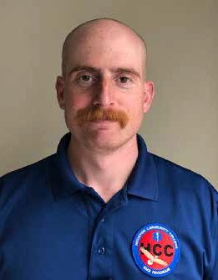
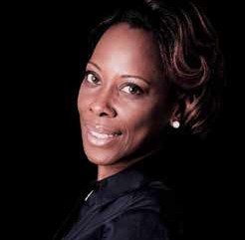
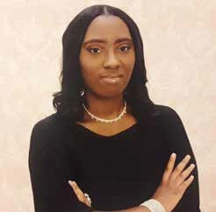
“I am a single mother of four children who is currently a cosmetology instructor with the goal of obtaining a bachelor’s degree in education. With your donation, I will begin to work on my long- term goal of working
at the HCC Cosmetology department. Thank you for your generous
donation, and I hope to be able to give back to this foundation in the future.”
Kirsten McDuffy
B.A & Frances Hamilton Scholarship
“I am a native Houstonian, and a loving and caring individual with an outgoing personality. I love volunteering and doing things for the community to spread humanitarianism. This scholarship will be very beneficial in helping me to continue my studies and in preparing me as I develop vocational skills to go out into the workforce.”
Calyn King
Assistance League of Houston VAST Scholarship
“I am currently volunteering at the Community Volunteer Fire Department and working part-time for the city of Alvin as an advanced emergency medical technician. Your generosity allows me to continue pursuing my career goals.”
Alexander Janouris
Houston Livestock Show & Rodeo PSI COE Scholarship
2

Slide 5
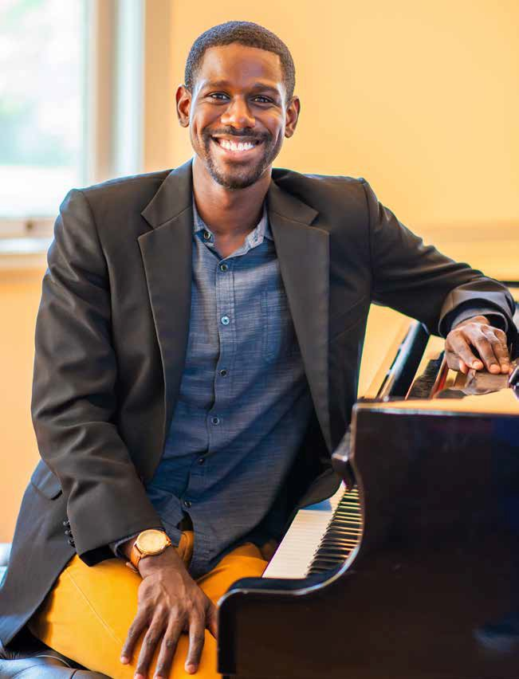
“This scholarship will aid me immensely as I work on finishing my pre-med prerequisite coursework, balancing my bills, paying for classes, and saving for the medical school application cycle.
The scholarship is an encouragement as well as financial assistance.”
Kyle J. Smith
Black History Scholarship
3

Slide 6
Thank you
for your partnership
HCC Foundation celebrates the incredible slate of Industry and Private Foundations partners who have joined HCC to date. Many of our partners you will recognize – some are major employers in our region, and some are also national and global leaders, household name-brand companies!
To our partners, you are investing in Houston’s future by investing in HCC students. You are truly the champions and advocates for HCC and our students out in the community.
Our partners represent many versions of “giving” to HCC through the Foundation: there are outright gifts and contributions to scholarships; some are in-kind donations of machinery and technology; others are program-specific investments to support targeted growth; and there is so much more.
We take pride in this fantastic representation – both new names from this fiscal year, as well as long-time partners – and we know there is work yet to be done. We want to thank you, our partners, for changing the trajectory of students and their families’ lives thereby investing in them and Houston’s economic development.
4

Slide 7










































5

Slide 8

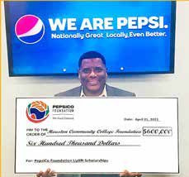
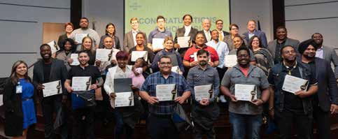
Donor
Spotlight
HCC Foundation partners with PepsiCo Foundation’s
Uplift Scholarship program
The educational path for Black and Hispanic students at HCC got better with fresh funding of $600,000, payable over two years, from The PepsiCo Foundation in spring 2021. Through this program, the college will offer a broad range of technical education and training.
Kyle Washington, GM market director for PepsiCo Beverages North America, presented the check to kick off the partnership between HCC and The PepsiCo Foundation during the HCC Board of Trustees meeting held in April 2021.
HCC is among the first four community colleges in the nation to partner with The PepsiCo Foundation Uplift Scholarship program, aimed at leveling the playing field for Black and Hispanic students to secure in-demand jobs with livable and sustainable wages.
“My goal is to set the standard for the generation ahead of me in my family by showing them my accomplishments of education and success,” says PepsiCo Uplift Scholarship recipient Olivia Marin, an HCC automotive technology student who plans to establish a woman-owned franchise of automotive services. “I am honored that you found me worthy of this esteemed scholarship.”
6

Slide 9
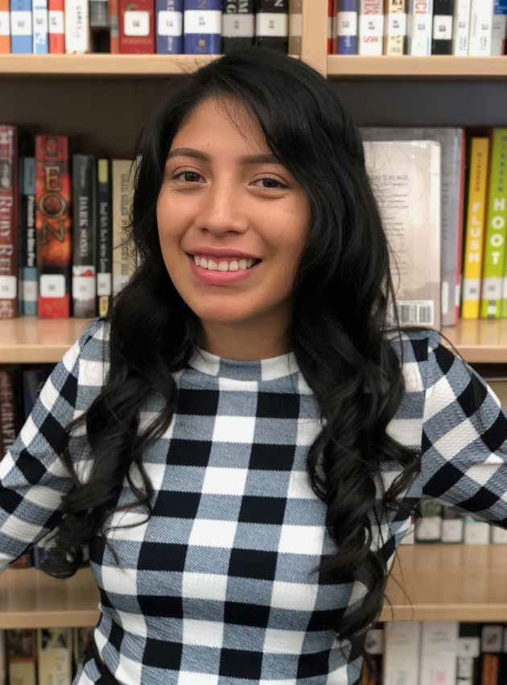
“Having this scholarship means it is a weight off my shoulders and my family’s because we
won’t have to worry about paying for tuition and books.
We are grateful for the generosity!”
Perla Lais
PepsiCo Uplift Scholarship
7

Slide 10
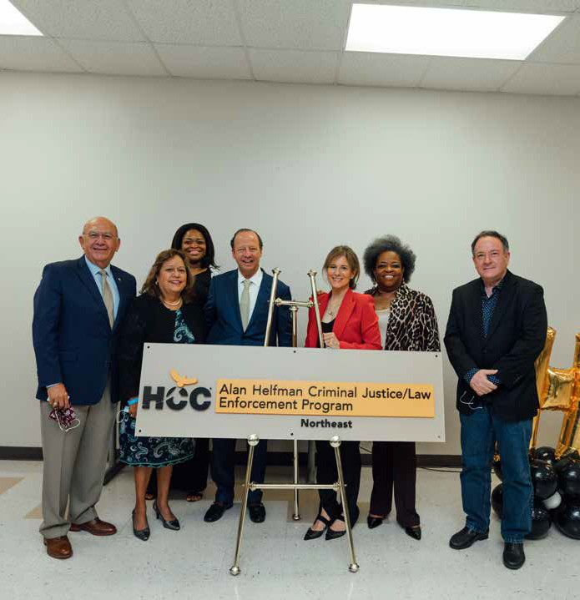
Donor
Spotlight
HCC PUBLIC SAFETY ALAN HELFMAN
NAMING
CEREMONY
8

Slide 11
Alan Helfman Criminal Justice/Law Enforcement Program Announced
HCC Foundation Ambassador Alan Helfman and his wife, Renee, have been actively involved in the Houston community for more than 30 years and have operated five very successful auto dealerships.
Alan tells friends that he learned at an early age the importance of giving back, and he has made that his commitment and has never turned down an opportunity to support initiatives for dozens upon dozens of worthy organizations.
In August 2021, the HCC Foundation celebrated Alan Helfman’s new gifts totaling more than $100,000 to HCC to aid the College’s law enforcement and public safety program. Helfman is passionate
about first responders and has conducted more than 100 fundraising efforts, raising millions upon millions, for various law enforcement agencies, especially the Houston Police Officers’ Union.
This commitment to law enforcement has meant that Helfman has been a supportive advocate of HCC and its Public Safety Institute at HCC Northeast College since 2003. His giving has helped to shape the learning environment of the Institute and enriched HCC students’ lives. Helfman’s latest contribution will do the same, helping individuals pursue public safety degrees, certificates and careers.
The honor of having Helfman’s name affixed to this award-winning HCC program is a representation of our gratitude for his generosity and support.
“Alan Helfman is well known to many for his leadership in the business community and his philanthropy.
His longstanding efforts to support our community encompass many contributions
to some of the most important institutions in our region. For that reason, many refer to him as Mr. Philanthropy. And it is a title that is well-deserved.”
Dr. Cesar Maldonado
HCC Chancellor
9

Slide 12
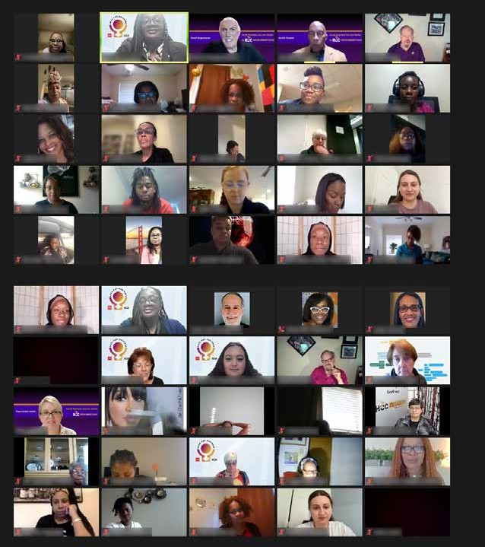





Donor
Spotlight
10

Slide 13
HCC Open for Business Powered by Wells Fargo
Open for Business is led by HCC’s Office of Entrepreneurial Initiatives with a $750,000 grant from Wells Fargo in 2021. The program empowers and accelerates the growth of women-owned businesses with a focus on Black, Hispanic, Inda-American, Native American, and Asian women. The program is empowering women as leaders through education, networking and mentoring.
Developed by the Glenda & David Regenbaum Center for Entrepreneurship - HCC Northwest, the Small Business Success Series by HCC is a five-module program that offers an opportunity for hands-on learning and interaction with faculty, guest entrepreneurs, business experts, and peer delegates. The series is specifically developed for entrepreneurs who are either planning to start a business, in the early stages of launch, or planning to grow their business. A Certificate of Completion is awarded to students who graduate from the series. The inaugural series had more
than 300 registrants and 64 percent of participants surveyed after completion of the session reported an overall increase in knowledge on entrepreneurship and running their business.
Presented by Open for Business Women Entrepreneurs, this series is offered at no cost thanks to the generosity of sponsor, Wells Fargo.
“We believe that women entrepreneurs are passionate visionaries with the ability to
take risks; innovators who can identify opportunities and through creativity, leadership and persistence, are able to turn ideas, product, and services into profit.”
Dr. Maya Durnovo
Chief Entrepreneurial Initiatives Officer
11

Slide 14
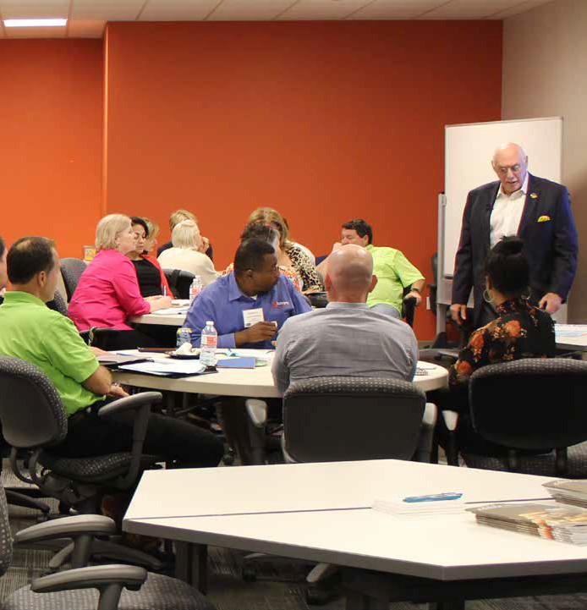

Donor
Spotlight
HCCF Board Chair and Northwest College
Entrepreneur-in-Residence David Regenbaum shares his industry knowledge with Goldman Sachs students.
12

Slide 15
Goldman Sachs Foundation 10,000 Small Businesses Program Stimulates Small Business Growth
Goldman Sachs 10,000 Small Businesses is an investment in a condensed program to help entrepreneurs create jobs and economic opportunity by providing greater access to practical business education, access to capital, and a supportive network of Advisors and Peers. The program operates as a partnership between Goldman Sachs and HCC and is housed at the HCC Alief Hayes Campus.
Goldman Sachs 10,000 Small Businesses has partnered with Houston Community College since 2010 to provide small business owners in the Greater Houston Region with access to practical business courses, financial capital and powerful networking opportunities to help their businesses grow.
Through the support of the Goldman Sachs Foundation, including gifts totaling nearly $850,000 in FY21, the program is offered at no cost to the business owners selected to participate in the GS10KSB program.
Designed by Babson College, the nation’s top-ranked entrepreneurship school, the curriculum focuses on practical business skills that can immediately be applied by business owners.
Small business owners receive one-on-one business advising and powerful networking opportunities. The program provides expert advice and technical assistance through partnerships with national and local business organizations, professional services firms, and the people of Goldman Sachs.
“Providing small business owners with
the tools and resources to identify opportunities to remain relevant
in any economic environment and developing a growth plan is the premise of the GS10KSB program.”
Michael Davenport
Business Advisor, Goldman Sachs
10,000 Small Businesses
13

Slide 16
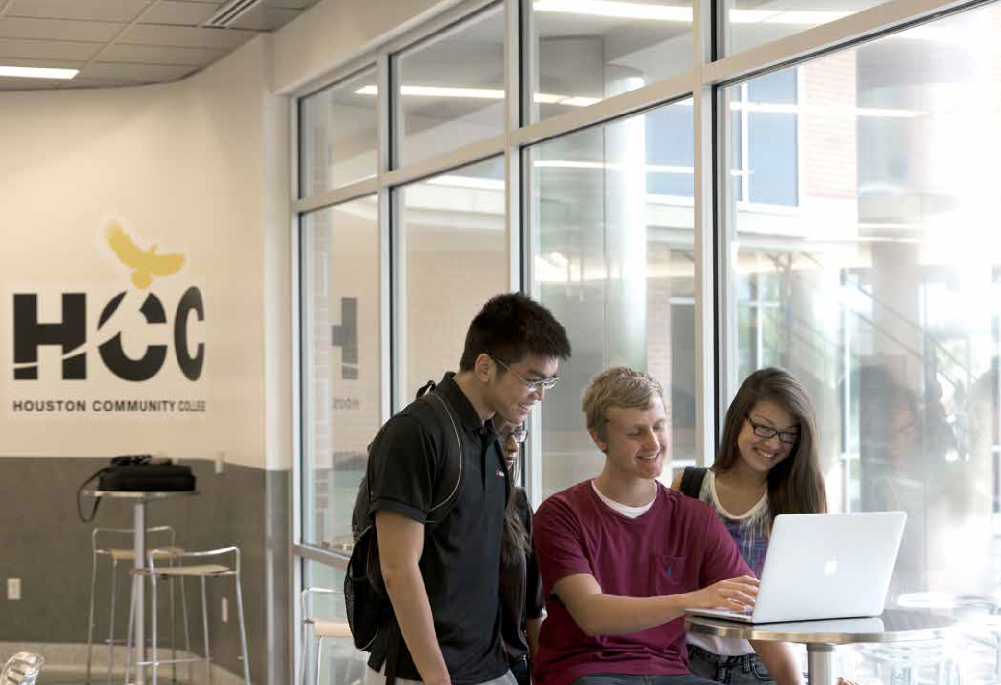
Donor Spotlight
14

Slide 17
Apple Community Education Program Brings Coding Opportunities to HCC Students
Since 2019, Apple has made a significant investment in HCC through its contributions and donations of Apple in-kind products for the benefit of HCC students through the Apple Community Education Initiatives Program. Apple’s goal with this program is to bring coding opportunities to more people in the Houston area and build job skills that lead our students to rewarding careers.
Through Apple’s donation, HCC will be able to expand the program, offering students access to the latest technology at Northeast, Southeast, and Central South regions of HCC campuses. In addition, the new mobile labs will allow flexibility within HCC’s service area
to offer additional innovative programs across the region, including support for summer STEAM (science, technology, engineering,
arts and mathematics) Camps. Also, creating an innovation center dedicated to training faculty and staff for professional development will continue to enrich the community-wide efforts across various Centers of Excellence at HCC. Apple is also expanding its support for HCC to hire an additional faculty fellow in support of the establishment of three mobile labs, three Innovation Centers, and one Train the Trainer Lab, which will benefit the entire HCC System.
“As a global leader in technology, Apple
continues to support community colleges
like HCC — understanding that greater access to knowledge opens
doors of opportunity.”
Dr. Madeline Burillo-Hopkins Vice Chancellor of Workforce Instruction and President, HCC Southwest College
15

Slide 18
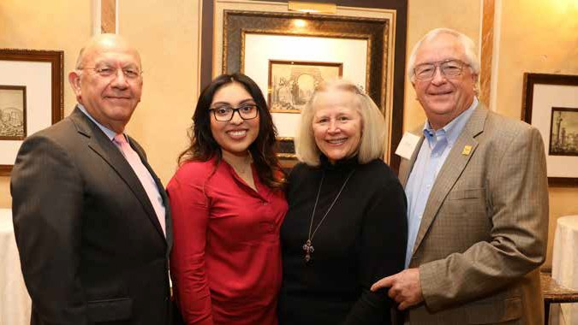
Donor Spotlight
The David & Jean Wiley Foundation Proudly Supports HCC Students
The David & Jean Wiley Foundation is a committed supporter to the HCC Foundation, generously contributing $1.6 million in scholarship support since 2010. Wiley scholars at HCC universally share words of appreciation for what the scholarship makes possible. “I would like my daughters to see that any goal can be accomplished if they want it to,” says Pamela Velazquez ’20 (pictured with HCC Chancellor Dr. Cesar Maldonado and Wiley Foundation Trustees Norma and Sam Gainer).
“I would like my daughters to see that any goal can be accomplished if they want it to.”
Pamela Velazquez ‘20
David & Jean Wiley Foundation Scholarship
16

Slide 19
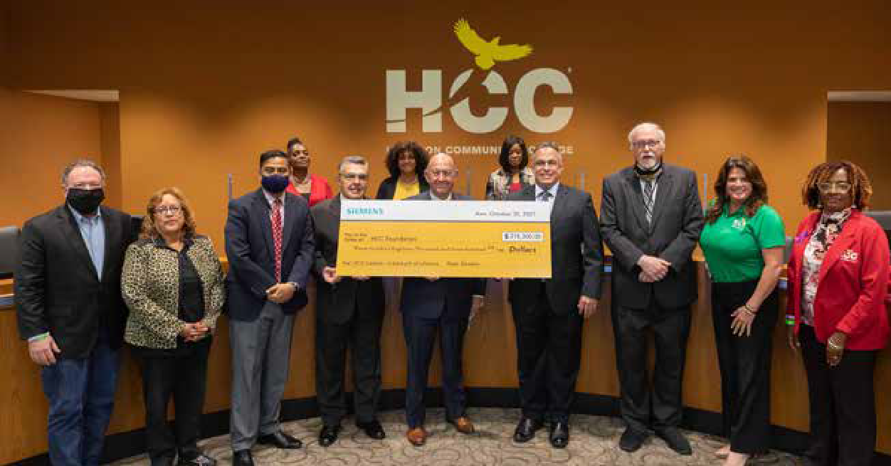
“Through our partnership with Siemens, together we will prepare the next generation of digital talent with the skills employers need today and in the future.”
Dr. Muddassir Siddiqi
HCC Central College President
Siemens Digital Industries Software Donation Boosts HCC Architectural Design and Construction Program
HCC Foundation is pleased to recognize Siemens Digital Industries Software, who awarded software valued at $318,300 through
a grant to HCC’s Central College in fall 2021 to support the Architectural Design and Construction Center of Excellence.
The award was recognized at the October 2021 HCC Board of Trustees meeting. Siemens representative, Senior Director, Global Strategy (Energy & Utilities), John Nixon (pictured top right of check) presented the check to HCCF and HCC officials, including HCC Central College President, Dr. Muddassir Siddiqi.
17

Slide 20
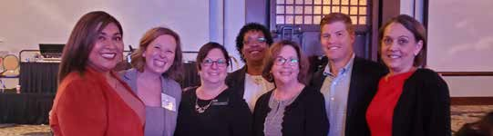
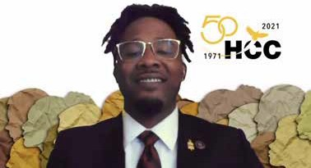
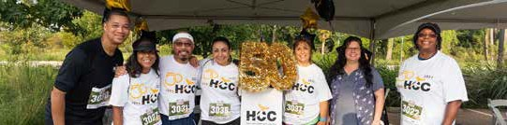
HCC Foundation in the Community
2021 National Philanthropy Day Luncheon
Celebrating the giving heart of Houston! From left, HCCF team members Rosa Argueta, Jill Assir, Kristina Perez and Marva Lawrence joined HCCF Board representatives Tracy Janda, Ryan McCauley and guest Jennifer Patton Grosvenor with Northern Trust at the 2021 National Philanthropy Day Luncheon hosted by the Association of Fundraising Professionals Houston Chapter at the Hilton Americas-Houston.
HESS Houston Corporate Run 5K
HCCF team members Marva Lawrence and Kristina Perez along with HCCF Board members Festus Amoye and Javeed Gire joined the HCC Team for the HESS Houston Corporate Run 5K last fall at Memorial Park. HCC was the sponsor of the water stops along the way. Go Eagles!
Rodeo Scholar Opens Fall Convocation
Houston Livestock Show & Rodeo Technical Scholarship recipient Markus Thompson presented the opening student testimonial at the HCC Fall Convocation. Houston Livestock Show & Rodeo is a long-time supporter of HCC student scholarships through the HCC Foundation. Thompson, a Process Technology student, inspired viewers with his message
of appreciation and uplift:
“Thank you for seeing me as deserving of such a reward. I plan on making the best of it.”
18

Slide 21
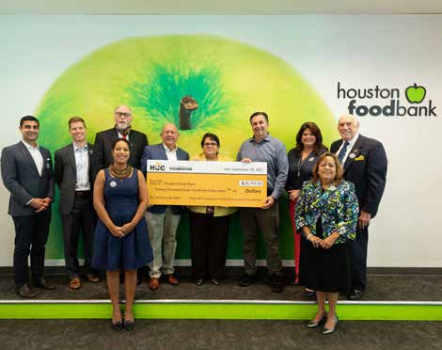
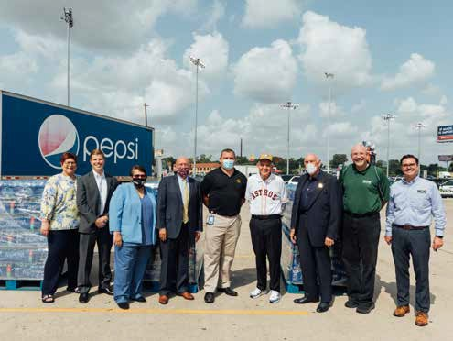
Helping Neighbors Who Were Impacted by Hurricane Ida: Teaming with Community Partners Houston Food Bank, PepsiCo and Gallery Furniture
The HCC Foundation rallied with HCC and community partners to help Louisiana neighbors in need following the impact of Hurricane Ida in September 2021.
The HCC Foundation presented a check in the amount of
$20,797 to Houston Food Bank President and CEO, Brian Greene in September 2021. HCCF Board Chair David Regenbaum, Vice Chair of Fundraising Ryan McCauley and Treasurer Cyrus Irani were joined by HCC Trustees, Chancellor Maldonado, and College Presidents for the presentation.
The HCC President’s Ida Relief Fundraising Initiative rallied
HCC faculty, staff, and students to provide support for our neighbors in Louisiana in need following Hurricane Ida. HCCF matched all donations up to $10,000.
HCC Foundation also teamed with The PepsiCo Foundation and Gallery Furniture to donate water and supplies to
those in need. With special appreciation to HCC donor and Houston philanthropist Jim “Mattress Mack” McIngvale for championing the drive at his stores.
HCC Eagles can and will make a difference, knowing that
We Are Stronger Together!
19

Slide 22
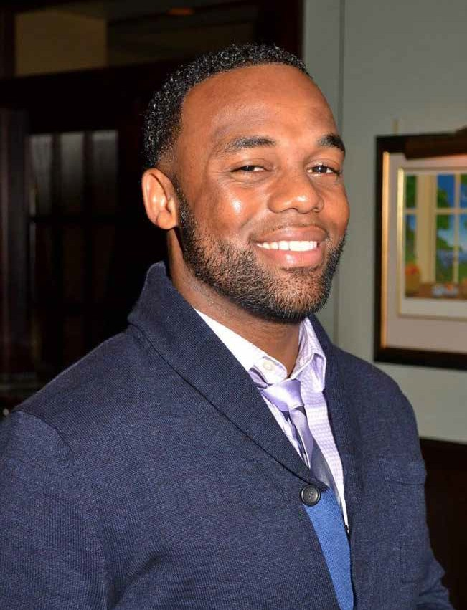
“I would like to thank you for awarding
me this scholarship which will be vital in helping me achieve my educational goals.
From the bottom of my heart, thank you! I have a diverse background which
includes 11 years in the United States Army as a combat medic and two tours in Iraq (2004-05 and 2009-10).”
Christopher Newkirk
PepsiCo Uplift Scholarship
20

Slide 23
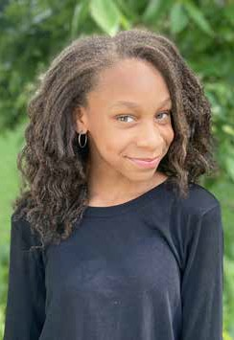
The HCC Foundation is deeply grateful for the generous support we receive from the community and for all that your contributions make possible for HCC students. In fiscal year 2021, September 1, 2020 - August 31, 2021, contributions to the HCC Foundation reached
$6.0 million through annual events, established partnerships, and continuing outreach. Most of these funds are restricted according to donor intent. In the same fiscal year, the Foundation provided $5.1 million in scholarships and grants to HCC. (See pie charts.)
FY 2021 Total Contributions
UNRESTRICTED FUNDS
$379,096
$1,677,891
DONATED ITEMS
GOLDMAN SACHS $849,751
$6,049,379
$3,142,641
SCHOLARSHIPS & PROGRAM GRANTS
“I am studying Mechanical Engineering and I am looking forward to my fall coursework. This scholarship will help me continue my coursework at HCC this year.”
Laila Combs
David & Jean Wiley Foundation Scholarship
FY 2021 Funds Provided to HCC
GOLDMAN SACHS
$836,037
$1,513,950
DONATED ITEMS
PROGRAM GRANTS
$1,299,536
$5,142,030
$1,492,507
SCHOLARSHIPS
21

Slide 24
Houston Community College Foundation
STATEMENT OF FINANCIAL POSITION
August 31 | 2021 | 2020
Assets
Current Assets
Cash and cash equivalents | $ 964,330 | $ 447,202
Contributions receivable | 333,835 | 379,714
Prepaids and other current assets | 69,804 | 124,725
Total current assets | 1,367,969 | 951,641
Noncurrent Assets
Contributions receivable, net of current | 17,412 | 42,062
Investments | 7,792,775 | 4,748,894
Investments, restricted for endowments | 10,555,055 | 10,499,140
Total noncurrent assets | 18,365,242 | 15,290,096
Total Assets | $19,733,211 | $16,241,737
Liabilities
Current Liabilities
Accounts payable | $ 500 | $ 21,982
Due to related party | 412,891 | 149,148
Total current liabilities | 413,391 | 171,130
Commitments and Contingencies
Net Assets
Without donor restrictions | 586,636 | 414,398
With donor restrictions | 18,733,184 | 15,656,209
Total net assets | 19,319,820 | 16,070,607
Total liabilities and net assets | $ 19,733,211 | $ 16,241,737
22

Slide 25

Houston Community College Foundation
STATEMENT OF ACTIVITIES
For the year ended August 31, 2021
 | Without Donor Restrictions | With Donor Restrictions | Total
Support and Income
Contributions and donations | $ 379,096 | $ 5,670,283 | $ 6,049,379
In-kind revenue from the System | 1,174,144 | - | 1,174,144
Investment return, net | 166,145 | 2,659,297 | 2,825,442
Vending and other income | 9,505 | - | 9,505
Net assets released from restrictions | 5,252,605 | (5,252,605) | -
Total support and income | 6,981,495 | 3,076,975 | 10,058,470
Program Services
Scholarships | 1,559,830 | - | 1,559,830
Grant distributions | 2,293,811 | - | 2,293,811
Student service distributions | 5,703 | - | 5,703
Donated Items | 1,677,891 |  | 1,677,891
Total program services | 5,537,235 | - | 5,537,235
Support Services
Fundraising | 776,460 | - | 776,460
Administration | 495,562 | - | 495,562
Total support services | 1,272,022 | - | 1,272,022
Total program and support services | 6,809,257 | - | 6,809,257
Change in net assets | 172,238 | 3,076,975 | 3,249,213
Net assets, beginning of year | 414,398 | 15,656,209 | 16,070,607
Net assets, end of year | $ 586,636 | $ 18,733,184 | $ 19,319,820
23

Slide 26
Donor Roll
Golden Eagle Society
SUMMA CUM LAUDE EAGLES
$100,000 and above
Thank you!
The HCC Foundation gratefully acknowledges all donor gifts. Your giving transforms lives.
Our donors provide life-changing scholarship funding and help support HCC’s ability to offer the latest technology and training to a diverse student body, across HCC’s 14 Centers of Excellence and network of campuses and satellite centers. In a year of change, our donors helped HCC students navigate a new normal for online learning.
Listed here are donor contributions of $250 and more made between
September 1, 2020 and August 31, 2021.
Apple
Barnes and Noble College Booksellers
David & Jean Wiley Foundation
E. David Brauer Estate
Siemens Digital Industries-Software Division
The Goldman Sachs Foundation
MAGNA CUM LAUDE EAGLES
$50,000-$99,999
William Fraser Houston Independent
School District
Houston Livestock Show & Rodeo
JPMorgan Chase & Co. May & Stanley Smith
Charitable Trust
The Marvy Finger Family Foundation
The PepsiCo Foundation Wells Fargo Bank
A & A Partners LLC BMC Software Inc. BP America, Inc.
Chevron
Mary W. Murrin
Deutser
Farah 1 International LLC
National Association for Community College Entrepreneurship
River Oaks Chrysler Jeep Dodge Ram
Alan Helfman
Scholarship America Volunteers of America Texas York Realty Investment LLC
DEAN’S LIST EAGLES
$25,000-$49,999
PVF Roundtable
Kim Shelton-Brown
AT&T Foundation (AT&T) Bank of America LiftFund
Glenda & David Regenbaum The Harris Center for Mental
Health and IDD
HEAD OF THE CLASS EAGLES
$10,000-$24,999
Erickson Living Management As Agent For Eagle’s Trace, Inc.
Greystar
Renee & Alan Helfman Houston Gateway Academy Elizabeth & Cesar Maldonado Microsoft Corporation
Aon
Assistance League of Houston Anna Lee & Kenneth R. Burton, Jr. Capital One
Julie & David D. Itz East End District
National Association of Student Personnel Administrators
Port of Houston Sony Electronics, Inc.
Summus Industries Inc. Wesley Community Center of
Houston TX
24

Slide 27
SOARING EAGLES
$5,000-$9,999
Amaanah Refugee Services Carla Antley
Association of Hispanic School Administrators
Roger D. Bumgardner Chapelwood United Methodist
Chickasaw Nation Education Services Fashion Group Foundation of Dallas, Inc. Gallery Furniture
H-E-B
Susan Akers Hirtz Husch Blackwell LLP Barbara G. Kile
Linda & David Knowles
Lamar High School Alumni Association Marjorie Goldberg Lott
LyondellBasell
Management To Learn USA LLC
Marine Corps Scholarship Foundation, Inc. Network of Executive Women in
Hospitality, Inc.
Occidental Petroleum Corporation
Jeanne Perdue
Jeanne Perdue Norma Perez
Janice & Patrick L. Pollan Royal Oaks CC Houston, Inc.
Ruth and Ken Arnold Family Fund San Antonio Area Foundation Karen L. Schmidt
Sports Authority Foundation The Astros Foundation
The Fashion Group Foundation of Houston, Inc.
The Honorable Borris Miles Sylvia Trumble
Tucker Education Foundation University of St. Thomas
Vintage Thunderbirds of Houston Wallis Bank
West U Rotary Club
Youth Financial Literacy Foundation
HONOR ROLL DONORS
$1,000-$4,999
5Works, Inc.
A Mind to Work Community Development Corporation
Accel Lifestyle, LLC Elaine P. Adams Pamela S. Alderman
Aldine Education Foundation Alief Independent School District Allegiance Bank Texas
Cecelia Allen
Army Emergency Relief Jill & Jason Assir
Association for the Advancement of Mexican Americans
Association of Jamaican Nurses of Greater Houston
Atlantic Housing Foundation AWS Foundation, Inc.
Antrece L. Baggett Basilian Fathers BB&T
Bethel Family Baptist Church Bethel Renewal Center A NJ Inc. Denise R. Boyd
Felicia M. Brooks
Brownwood Community Advisory Council
Shepley Bulfinch Wren M. Bump
Madeline Burillo-Hopkins Carlyn Burton
Camden Property Trust Camellia Alise Inc.
Carlos Garcia Realty, Inc. CenterPoint Energy Central Christian Church
Endowment Fund
Charities Aid Foundation of America
Children of Fallen Patriots Foundation Choctaw Nation of Oklahoma
Nirav J. Chokshi
Citizens for Educational Excellence Clarice Jones Scholarship Fund Inc. Click2Houston
CLWE The Forthy Plus Models, Inc. Community Foundation of Collier County Cy-Fair Educational Foundation
Drake Auxilio Divino Dress for Success Houston
East End Area Chamber of Commerce Elkins Elite Booster Club
Enterprise Holdings Foundation ErmaRose Winery LLC Katherine Fields
Fiesta Missionary Baptist Church Formosa Plastics Corporation, Texas Fort Bend Friends & Neighbors
Foundation
Fort Bend ISD
Fort Bend Medical Society Foster Care To Success Elizabeth Fraser
Girls Inc. of Tarrant County Janice & Robert Glaser Melissa N. Gonzalez
Gonzalez Baptist Asssn. WMU Shantay R. Grays
Greater Houston Business Procurement Forum
Greater Houston Frontiers Club Rita Grogan
Marc Grossberg
Gulf Coast Regional Blood Center Debbie C. Hamilton
Zandra D. Henderson
Highlands Rotary Club Charitable Foundation
Hiketron Inc.
Anna & Zachary R. Hodges Holy Child Charity, Inc.
Hope of Harvest
Houston Architecture Foundation Houston Area Glass Assoc.
Houston Area Urban League
Houston Automotive Dealers Association Houston Country Club Scholarship Fund Houston Heights Lodge #225
Houston Junior Forum Houston Striders Iconoclast Artists
Interfaith Ministries for Greater Houston Lillian & Cyrus Irani
Kenneth W. and Tracy D. Janda Jefferson Davis Hispanic
Alumni Association
John F. Connelly Scholarship Fund Jones Memorial United Church JSL Education Foundation
Kallen Enterprises
Katy Independent School District Katy Rotary Fund
Kluck Foundation Inc.
Knights of Columbus Council 9708 Lakeside Country Club
Mary P. Lawson
Leland College Prep PTO
Lilly Grove Missionary Baptist Church Macmillan Holdings LLC
dba Hayden-McNeil
Nancy R. Manderson
Marathon Petroleum Company LP John N. Marek
Jerry Martin Zoran Maslovaric Janet L. May
Jessica & Ryan F. McCauley Vicki McCullough
25

Slide 28
HONOR ROLL DONORS
(CONT.)
Memorial Spring Branch Rotary Charities, Inc.
Milby Hispanic Alumni Association
Moody Foundation John Munday Mary W. Murrin
My Manas Foundation Navasota George Washington
Carver High Alumni Association
Out For Education
Overseer R.L. Braziel Scholarship (DOERS)
Pan American Round Table of Houston
PaperCity Magazine PBK, Inc.
Roy Montalbano
Paula & Mark Permenter Permit Us Now
Cydney H. Peters
Phi Beta Kappa Alumni La Vonne Pitney
Plumbers Local Union, No. 68 Robert C. Powell
Fheryl J. Prestage &
The Honorable Grady Prestage
Progress In Education Project GRAD Houston Reagan Lodge #1037 A.F.
& A.M.
Robert H. & Katharine Garff Foundation
Faanya Rose
RSB Environmental Karen P. Saenz
San Jacinto High School Alumni Association
SBISD Pine Shadows PTA SEPHORA
Cammy Shay
SMART Scholarship Funding Corp
Peggy & E. Ashley Smith Ron Smith
Society of Iranian American Women for Education
Spring Branch Education Foundation
St. Anne Catholic Church
St. Paul Scholarship Foundation Stafford MSD Education
Foundation
Street School Inc. Ellen Susman
Jackquline Marie Swindle Taylor Whitley Show Up
Scholarship
Mia Taylor TDIndustries, Inc.
Tehrani & Associates, LLC Texans Can Academies Texas Tennis and Education
Foundation
Texas Theatre Adjudicators & Officials (TTAO)
The Aihua Foundation, Inc. The Bold Foundation
The Cherokee Nation The D. Lynd and
Terri K. McGowan Foundation
The Employee Association of Metro T.E.A.M.
The Exchange Club of Missouri City
The Honorable Christina Morales
The Houston Association of Panamanians, Inc.
The Marie Roper Foundation The Navajo Nation
The Salvation Army
Mr. and Mrs. Phillip Thompson TJFACT, Inc.
TWST4Girls Monique Umphrey United Concordia
Univision Communications Jennifer R. Vacca
John J. Vasselli Verizon Patricia Vice
West Houston Medical Center Westbury Baptist Church David B. White
Work Texas Training Center Janet Wormack
Charles Yates
Cynthia Belmar Bethel’s Place Marland Bibbs Lorraine Bisch Cecilia Bonnor Vedron Bordeaux
Nichole C. Boutte-Heiniluoma Saundra Y. Boyd
Margarita P. Bracamonte Loris Bradshaw
Ravi Brahmbhatt Sheila Briones Jesse Brown Jessica A. Brown Katherine Bruton Khalid M. Bukhari Evelyn V. Burgos Dorothy E. Caram Danita B. Carey Jordan D. Carswell Diana Castillo Robert C. Castillo Leonard L. Cazares Rachel Cevallos
Sarath K. Menon Chembottil
CHI St. Luke’s Health/Baylor St. Luke’s Medical Center
Chick-Fil-A (Holcombe) Cinco Ranch High School Terri B. Clarkson
College Consultants of Colorado
Edgardo E. Colón Community National Bank Parish Conkling
Terrance Corrigan Nicholas P. Cox Lisa A. Crawford Jennifer J. Crispin
James David Cross
Daddy’s Girl Second Chance Foundation
Robert M. Davenport Melinda E. Davila Ronald Desbrow
Gaynelle & Prem B. Dewan Kathleen Dillon
Dime Box Lions Club Linda Downing-Adkinson Otis R. Drew
Maya Durnovo Daniel Dylla Juanita P. Edgerton Michael J. Edwards Kurt Ewen
Fayette Resale, Inc.
Second Chance Emporium
First Presbyterian Church Lane Fletcher
Margaret L. Ford Fisher Former Player Benefits Trust Fort Bend Independent School
District
Fort Worth Stock Show & Rodeo Friends of Westbury High
School Foundation
Ilija I. Gallego Howard C. Galloway Gap, Inc.
Charlene White
Katrina Gary-Forte Matias Garza
Sheryl T. George-Jones Kendrick L. Gibson Angela M. Glaser
Pete Gomez Larry J. Gonzalez
Richard J. Gosselin
MENTOR EAGLE DONORS
$250-$999
Gisela R. Ables
Alan Ainsworth & Lee Harrison Salim Al Salmi
Aleca Alejandro
Alpha Phi Alpha Fraternity, Inc. American Institute of Architects Jae An
Angela A. Anderson Bennie Ansell Mehmet Argin Daniel L. Argo Laura E. Ayers
Laurel K. Barker-Edwards Diana C. Barrero-Burgos Maria G. Esther Bazan-Myrick Kendra Belfi, MD
26

Slide 29
Lorah D. Gough William C. Graham
Harris County Labor Assembly Duncan Hasell
Marshall Heins Aaron L. Henry Derry Herlihy Edmund Y. Herod Kathie Herod Stacey A. Higdon Brandon Hodge
Houston West Chamber of Commerce Warren L. Hurd
Imperial Guard Alumnae Javed Iqbal
Thomas Jay Sofia John
Machuria M. Johnson Wayne Johnson
Raj Joseph Justice Forward
Zaza Kabayadondo
Katy High School Choir Association Jodie Khan
Statha L. Kline-Cherry Komala Krishnaswamy
La Michoacana Foundation Laurel A. Lacroix
Lamar All Sports Booster Club Anne M. Lander
Marva Lawrence Robert Livitz Lonnie R. Long, Jr. Martha S. Lopez Eva L. Loredo
LyncVerse Technologies Joy L. Marshall Khambrel Marshall Jamie A. McCleskey
Robert J. McCracken Helen M. McMillan Michael’s Cookie Jar, LLC Melissa A. Miller-Waters Lakessa N. Monroe Nicole Montgomery Monty & Ramirez LLP David E. Moore
Victoria L. Mujahid
National Society of Collegiate Scholars Timothy Nelson
Thao Nguyen
Pamela M. Norwood-Todd Charles Nwankwo
Rita S. Oubre
Panhandle Groundwater Conservation District
Donald R. Parker
Pearson Education/HEPG-Longman Publishers
Giovanna H. Pennick Cheryl Peters
Shilpa Phanse Scott Pitney
Pleasant Hill Winery
Pollan Hausman Real Estate Services, LLC Connie Porter
Power on Heels Fund Pragathi
JoEllen Price Pro-Vision, Inc.
Guillermo T. Quijano, Jr. Miguel Ramos
Russell Rau Colleen K. Reilly Monica F. Richart
Katherine D. Robinson Keitha Robinson
Rod Lemon Foundation
Samantha M. Rodriguez Richard Rosing
David A. Ross Elizabeth Scherer Angela Secrest
Nithy Sevanthinathan Kim L. Shelton-Brown Laura Sherman Juanna Shin
Paralee A. Shivers Donna Smith Louis E. Smith David Smock
Society of Professional Women in Petroleum
Southern Sound & Lighting SpringSpirit Inc.
Michael D. Stafford
St. Cyril of Alexandria Catholic Church Stafford Municipal School District Jeffrey M. Stear
Supernova Furniture LLC Adriana E. Tamez
Tallwood High School Band Boosters Texas Academic Decathlon
Texas Longhorn Breeders Gulf Coast Association
The ASPIRE Network
The Congregation of The Sisters of Charity of The Incarnate
The Home Depot
The James E. Taylor High School Total Wine & More
Michael W. Trest Annie L. Tsui Velva Tyson Patricia Ugwu Steve Underwood
University of Houston
Alberto M. Urbina Erhan Uskup Cristian Ventura Carlos H. Villacis Michele R. Voight
Waelder I.S.D. Scholarship Account Pauline Ward
Carol & Robert Watson Laura & Robert Williamson Michael Webster
Colleen West John Wormack Mia Wright Sharon R. Wright Karen B. Yip
YMCA of Greater Houston Remmele J. Young
MATCHING GIFT PROGRAMS & DONOR-ADVISED FUNDS
Austin Community Foundation California Community Foundation Fidelity Brokerage Services LLC Fidelity Charitable Gift Fund Greater Houston Community
Foundation
Houston Jewish Community Foundation International Scholarship and Tuition
Services, Inc.
Shell Oil Company Foundation Shell Oil Company HERO Program
The Benevity Community Impact Fund The Blackbaud Giving Fund
U.S. Charitable Gift Trust
The HCC Foundation makes every effort to ensure the accuracy of names listed in this donor acknowledgment. Please send notice of incorrect listings to foundation@hccsfoundation.org
or call 713.718.8595.
27

Slide 30
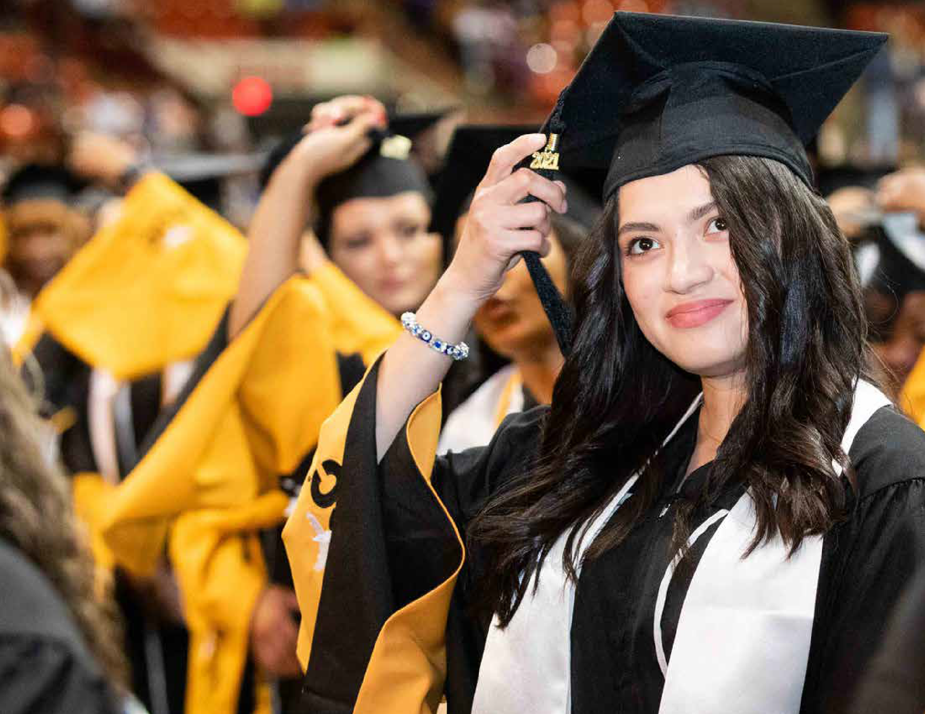

Make a gift.
Build a personal legacy.
The HCC Foundation offers many ways for donors to create a legacy through financial support of deserving HCC students working to achieve higher education and a better life.
Every gift makes the impossible possible.
Your donation of any size allows us to offer more Houston-area students the chance to get ahead. At the same time, their newfound knowledge and skills enrich our community and the success of us all.
We sincerely appreciate your support at every level.
Learn more about how your gift can make a difference at hccsfoundation.org/donate or call 713.718.8595.
Named Scholarship or Program Fund
With a gift of $10,000 or more, you may establish
a legacy in your name or in honor of a special person of your choosing.
Named endowment
With a gift of $25,000 or more, you may endow
a fund that will guarantee support for students in perpetuity.
Planned giving
You may also leave a legacy at HCC through your estate.
The HCC Foundation website offers suggestions for planned giving, and we would be pleased to assist you in developing a plan to establish the legacy you seek.
28

Slide 31
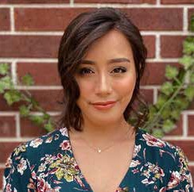
GIFT VEHICLE | HOW TO MAKE THE GIFT
Cash | Check or credit card
Transfer of Stock or Cryptocurrency | Transfer stock or cryptocurrency directly to the HCC Foundation; Contact the HCC Foundation
Life Insurance Gift | Gift a policy with the HCC Foundation as the beneficiary; Contact the HCC Foundation
Donor Advised Fund | Direct your Donor Advised Fund holder to make a specified gift to the HCC Foundation
In-Kind Gift (such as teaching technology, equipment, vehicles, etc.) | Contact the HCC Foundation
Retirement Plan Gift | Name the HCC Foundation as beneficiary of the remainder of the retirement assets after your lifetime; Contact the HCC Foundation
Legacy and Planned Gifts | Name the HCC Foundation in your will as beneficiary of your assets/estate; Contact the HCC Foundation
“This scholarship will ultimately help finance my place in HCC’s Radiology program as well as
the supplies I need to be successful throughout this pathway. I am incredibly thankful for the David
& Jean Wiley Foundation Scholarship, and can’t wait to finish my program with the help of this much needed award.”
Shelby Castro
David & Jean Wiley Foundation Scholarship
For more information, contact Karen L. Schmidt, MBA, CFRE, President, HCC Foundation, at 713-718-8595 or via email at karen.schmidt2@hccs.edu.
29

Slide 32
HCC Foundation Staff
Karen L. Schmidt, MBA, CFRE
President
Executive Committee
David Regenbaum, Board Chair
Entrepreneur
David D. Itz, Vice Chair of Governance
Energetic Properties/First Service Credit Union
Ryan McCauley, Vice Chair of Fundraising and Chair-Elect
Northern Trust
Tracy Janda, Vice Chair of Board Relations
Community Volunteer
Cyrus Irani, Treasurer
Fairview Energy Capital
Jeanne M. Perdue, Secretary
Occidental Petroleum
Araceli Alvarez ’18
Executive Assistant to the President
Rosa E. Argueta
Annual Giving Specialist
Jill Assir, MBA, CFRE
Director of Development
Felicia Brooks
Scholarship Coordinator
Rosalinda Garza
Part-time Program Assistant
HCC Foundation Board of Directors
Cecelia Allen
Kinder Morgan, Inc.
Festus Adeleke Amoye
Laddering Your Success
Dr. Antrece L. Baggétt
Houston Community College, Faculty Liaison
Jesse Brown
Ellis Brown + CO.
Carlyn Burton
Osha Liang LLP
Kenneth R. Burton, Jr.
Community Volunteer
Edward Fierro
Bracewell
Javeed Gire
Richmond Printing
Dr. Mary Lawson
Houston Community College, Faculty Liaison
Arturo G. Michel
City of Houston
Roy Montalbano
PBK
Mary W. Murrin
Chevron
Dr. Eddie L. Patton, Jr.
Vyripharm Enterprises, LLC
Nicole Riley, CPA, CFE
Pannell, Kerr, Forster (PKF) Texas
Lina Sabouni
AUTOARCH Architects
Dr. Kim Shelton-Brown
Welding Outlets Inc.
Courtney Taylor
Veritex Community Bank
Irsan Tisnabudi
Aria Services, Inc.
Charlene White
Gap, Inc.
HCC Board of Trustees Liaisons
Eva L. Loredo
Secretary, Trustee District VIII (Ex-Officio)
Dr. Pretta VanDible Stallworth
Trustee District IX (Ex-Officio)
Ex-Officios
Cesar Maldonado, Ph.D., P.E.
Chancellor, HCC
Karen L. Schmidt, MBA, CFRE
President, HCC Foundation
Zandra Henderson, ’07, ’08, MPA
Advancement Services Manager
Marva Lawrence
Prospect Researcher
Claudia Martinez
Program Assistant, Gift Processing
Simonne Muhammed
Program Assistant, Scholarship
Kristina Perez, M.Ed.
Director of Development
Cydney H. Peters, M.Ed., GPC
Annual Giving Director
Dr. Lynnette Redd
Director of Development
Sylvia Romero ’00
Board Services Coordinator
Griselda Vaglienty
Part-time Program Assistant
Rosie Villegas ‘20
Accounting Specialist
30

Slide 33
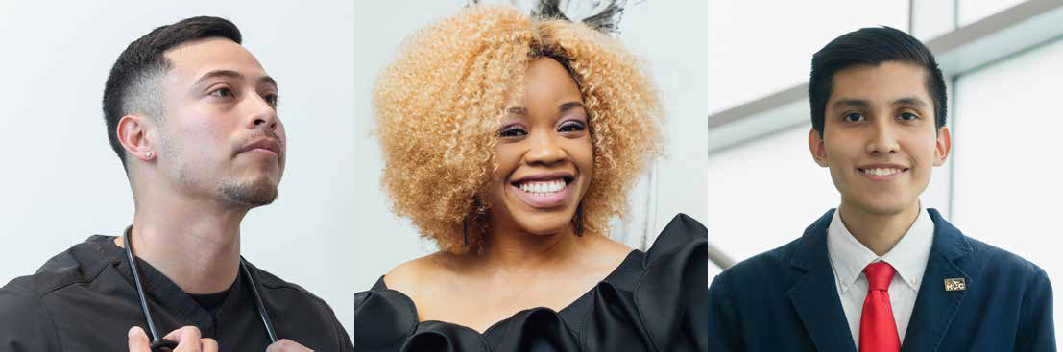
Inspire Tomorrow,s Leaders.
It’s easier than you think to make a difference that will benefit future generations. Consider making a bequest to the Houston Community College Foundation as part of your estate plans.
By including HCCF in your will, your gift will help future generations of Houston students earn a college degree and achieve their potential.
For more information, contact Karen L. Schmidt, MBA, CFRE, President, HCC Foundation, at 713-718-8595 or via email at karen.schmidt2@hccs.edu.
31

Slide 34
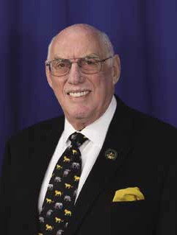

A Closing Message from the HCC Foundation Board Chair
“I truly appreciate your kind generosity. I am very excited to receive this special opportunity. Being selected as one of the awardees for the 2021-2022 year helps me both financially and with the recognition that I have chosen the right path for
my education.”
Leonor Poindexter Glenda & David Regenbaum Scholarship
Dear Fellow Philanthropists and Investors,
On behalf of my fellow HCC Foundation board members, we extend our collective appreciation for your philanthropic support of Houston Community College students – Houston’s students.
HCC is the economic engine for Houston’s workforce, training students in relevant, high-quality education and training, ensuring success for all students,
our community, economy and beyond. The HCC Foundation helps to fuel this engine and place HCC students on the path to their educational and career pursuits with scholarship support received from our generous donors. Your investment in
our students benefits families and future generations – an investment that will reap benefits for many years to come.
As Entrepreneur-in-Residence at HCC Northwest and a member of HCC’s entrepreneurial faculty, I continually see innovation come to life and new businesses launch from ideas sparked in HCC
classrooms. The necessity for HCC to pivot and adapt to new learning technologies across the pandemic is embodied in HCC’s Entrepreneurial programs with innovation at its core – and lifting innovators who can identify opportunities and take risks to succeed.
This ability to connect innovators with the training and resources needed to grow their entrepreneurial ideas mirrors the HCC Foundation’s passion to connect our donors with the students and programs you are each helping to impact with your financial
support. Our scholarship recipients are passionate about achieving their goals; each has a personal story of overcoming challenge and risk on their journey forward.
As Board Chair for the HCC Foundation, one of the greatest joys to witness is the life-changing impact of our donors’ generosity. On a personal note, my wife, Glenda and I are humbled each semester by the grateful words of our named scholarship recipients.
Leonor, an HCC student and Foundation scholar, writes, “I truly appreciate your kind generosity.
I am very excited to receive this special opportunity. Being selected as one of the awardees for the
2021-2022 year helps me both financially and with the recognition that I have chosen the right path for my education.”
Thank you for joining me to place more students like Leonor on the path to a brighter future.
Together, we are investing in Houston’s future by framing the futures for HCC students. Together, we are making a difference that is meaningful and will resonate for generations to come.
Sincerely,
David Regenbaum
Board Chair
HCC Foundation Board of Directors
32

Slide 35
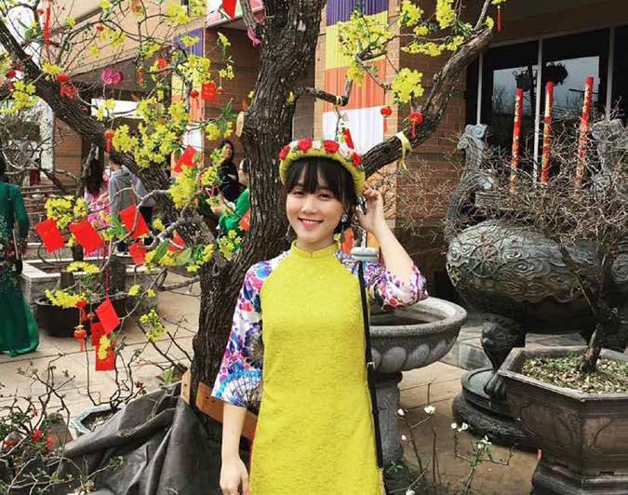
“I am an international student from Vietnam so I usually tell myself that I have to try harder than the others. By awarding me, you have lightened my financial burden which allows me to focus more on the most important aspect of school, learning. Your generosity has inspired me to help others and give back to the community.”
Hoang Luong
Marjorie Goldberg Lott Scholarship

Slide 36


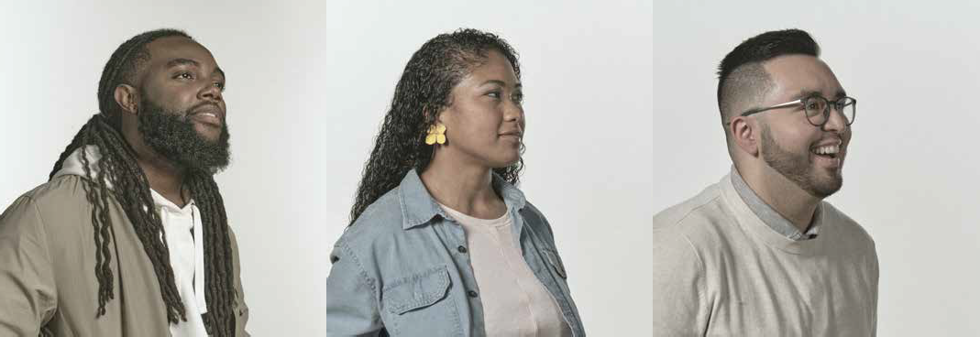




3100 Main, Suite 12B12 (MC 1148), Houston, TX 77002
713.718.8595
hccsfoundation.org
TYRIK T.
ASHLIE T.
ALEJANDRO M.
LinkedIn/Houston Community College Foundation
facebook.com/HoustonCCFoundation
twitter.com/HCCFoundation
Houston Community College Foundation
is a BBB Charity Member and a BBB Accredited Charity.

