Slide 1
Insights from the
Bridge (Puente) Program
Desmond Lewis, EdD
Associate Vice Chancellor, College Readiness
Annie Tsui, MA
Interim Dean, College Readiness
Samantha Rodriguez, PhD
Professor and Bridge (Puente) Program Co-Coordinator
Syble Davis, MA
Professor and Bridge (Puente) Program Co-Coordinator
April 24, 2023

Slide 2
Overview
Program Overview
Success Approach
Student Cohorts
Course Success Rates Comparison
Student Demographics
Retention Rates
Awards Earned
Transfer Institutions

Slide 3
What is the Bridge (Puente) Program at HCC?
The Bridge (Puente) Program is for students who want to excel in both academic and career goals while in community college. Students enjoy the benefits of working with classmates, faculty, and support staff outside of formal class activities. With this added boost, students will more readily excel in academic work on the way to completing their degree programs. Students will also develop better interpersonal and leadership skills.
The Bridge (Puente) Program at HCC is a cohort modeled student success program that focuses on culturally relevant and culturally responsive practices that help to ensure a holistically reflective educational experience for students. It is based on the nationally recognized Puente Project.

Slide 4
Benefits for Students
Become part of the Bridge learning community of students
Become a Bridge Ambassador
Experience Field Trips to Colleges and Universities
Experience Family Nights for Bridge Participants
Enjoy a close working relationship with Bridge advisors
Scholarship Opportunities
Participation in culturally enriched activities

Slide 5
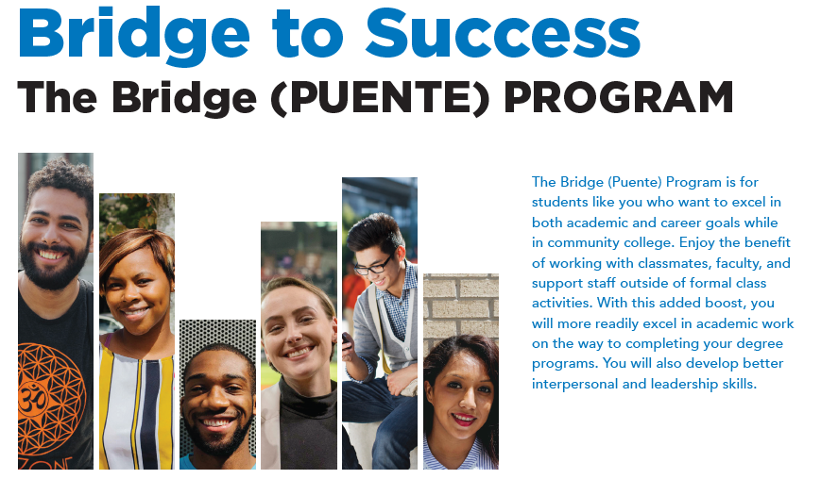
HCC’s Bridge (Puente) Program
Webpage: www.hccs.edu/programs/the-bridge-puente-program/
Email: hcc.thebridge@hccs.edu
Zoom Lobby: www.hccs.edu/applying-and-paying/virtual-lobby/ (click under Academic Depts on Zoom)

Slide 6
Let’s Talk
Expected Outcome
Understand the Bridge (Puente) Program framework
How the topic relates to Student Success
How the topic is connected to Equity and Equity-Mindedness
Results that show evidence of success/equitable outcomes
Directions: Please get into groups of 3, Select a Recorder, Speaker, and Answer the following questions.
Do you see any other benefit(s) that can be derived from the Program?
What are some other cultural opportunities of engagement that would help to build a sense of belonging amongst out community of learners and practitioners?
5 minutes

Slide 7

5 minutes

Slide 8
HCC Bridge (Puente) Program Videos
Overview of the Bridge (Puente) Program
https://www.youtube.com/watch?v=zogymOYqrYU
HCC Bridge (Puente) Student Testimonies
https://www.youtube.com/watch?app=desktop&v=zR2geDcMfM0&feature=youtu.be
The Bridge (Puente) Mentor Program
https://www.youtube.com/watch?v=nHvQzYy7ydo

Slide 9
Bridge (Puente) Program Courses
As part of HCC’s Bridge (Puente) Program, students enroll in at least two of the following cohorts each semester. Classes are 16 Weeks (RT) or 12 Weeks (SS). Modalities are in-person (P) or on online with a schedule (WS).
Fall Semester
Spring Semester
ENGL 1301
ENGL 1301+INRW 0300 (Corequisite)
EDUC 1300
HIST 1301, 2327, or 2381
MATH 1314 OR
MATH 1314+MATH 0314(Corequisite)
MATH 1332 OR
MATH 1332+MATH 0332 (Corequisite)
ESOL Level 3 (0349, 0350, 0351,0352) ESOL Level 4 (0353, 0354, 0355,0356)
ARTS 1301
ENGL 1302
ENGL 1301 + INRW 0300 (Corequisite)
ENGL 1301 + ESOL 0370 (Corequisite)
ESOL Level 4 (0353, 0354, 0355,0356)
HIST 1301, 1302, 2328, or 2382
HUMA 1301
MATH 1314 OR
MATH 1314 + MATH 0314 (Corequisite)
MATH 1332 OR
MATH 1332 + MATH 0332 (Corequisite)

Slide 10
HCC Bridge (Puente) Advisors
Each College has designated Bridge (Puente) Advisors to provide students with support and guidance. Bridge (Puente) Advisors also assist with student onboarding through referrals and course selection based on student need and interest.

Slide 11
Let’s Talk
Expected Outcome
Understand the student needs in alignment with course offerings
How the topic relates to Student Success
How the topic is connected to Equity and Equity-Mindedness
Results that show evidence of success/equitable outcomes
Directions: Please get into groups of 3, Select a Recorder, Speaker, and Answer the following questions.
Besides current Bridge (Puente) Program faculty and advisors, what other groups at the College should be a part of the Program?
Are there any other courses besides those mentioned that should be added as part of the Program’s course offerings?
5 minutes

Slide 12
5 minutes

Slide 13
3E Model
Success Approach
EXPANSION
(Structural Bonding)
HISD Partnerships to include Dual Credit
Minority Male Initiative (MMI) Partnership
Adult Education Literacy (AEL) Cohort
HUMA Area Studies Cohort
Online Cohort Expansion
EXPOSURE
(Social Bonding)
Partnership with Tutoring Supports
Bridge (Puente) Student Org.
College-wide Bridge (Puente) Professional Development
EXPERIENCE
(Financial Bonding)
Bridge (Puente) Student Ambassadors
OER Supports
LibGuides (Library)

Slide 14
Expansion: Student Cohorts
Past Cohorts
2020-2021
Current Cohorts
2022-2023
14 cohorts
Locations: Online, Northline, Eastside, Alief Hayes, Alief Bissonnet, West Loop, Katy, Missouri City, and South Campus, Central Campus
Students: 612
2 Cohorts
Locations: Northline, Eastside
Students: 47
2021-2022
14 cohorts
Locations: Online, Northline, Eastside, Alief Hayes, Alief Bissonnet, Missouri City, and South Campus
Students: 587
*Note: Student count is an average of Fall and Spring enrollment

Slide 15
Exposure:
HCC Bridge (Puente) Events 2022-2023
Fall 2022
Spring 2023
Family Day at Northline Campus
Bridge (Puente) Southeast College
Meet and Greet
Latina/o History Month
Speaker: Russel Contreras
Latina/o History Month
Speaker: Amanda Ellis
Bridge (Puente) Club
Speaker: Diana Hernandez
Bridge (Puente) November Newsletter
Bridge (Puente) Central College Meet and Greet
Bridge (Puente) Alief Bissonnet Campus Meet and Greet
Black History Month
Speaker: Samuel Hogsette
Black History Month
Speaker: Van Roundtree
Women’s History Month – Linda Garcia Merchant
Women’s History Month – Gabriela Magaña
Bridge (Puente) Club Financial Literacy Workshop
Transfer Workshop
Bridge (Puente) March and April Newsletter
End of Year Celebration

Slide 16
Experience:
Bridge Ambassadors
Bridge Ambassadors are recruited HCC students in the Bridge (Puente) Program.
Bridge Ambassadors’ role is to promote awareness of the Bridge (Puente) Program throughout the college and assist with student recruitment, attend various events, and provide program support.

Slide 17
Let’s Talk
Expected Outcome
Understand the Bridge (Puente) Program framework
How the topic relates to Student Success
How the topic is connected to Equity and Equity-Mindedness
Results that show evidence of success/equitable outcomes
Directions: Please get into groups of 3, Select a Recorder, Speaker, and Answer the following questions.
How can we continue to leverage the 3E Model (Expansion, Exposure, and Experience) for the Program?
5 minutes

Slide 18
5 minutes

Slide 19
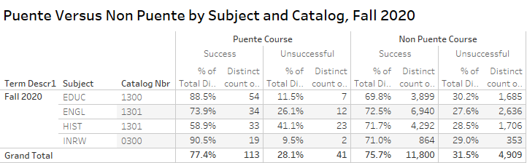

Slide 20
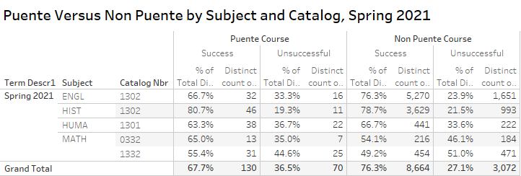

Slide 21
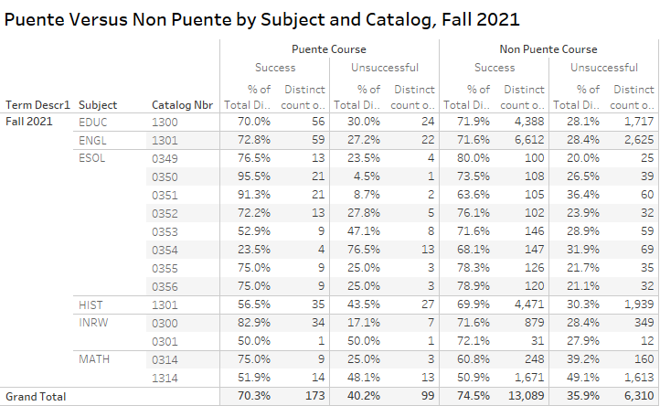

Slide 22
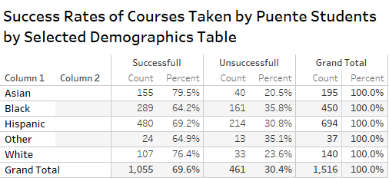

Slide 23
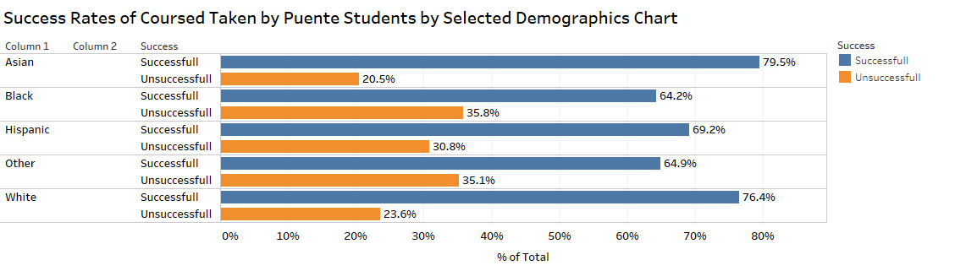

Slide 24
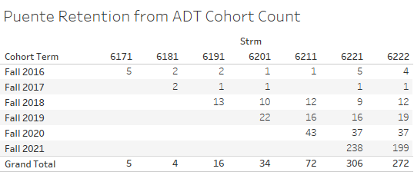

Slide 25
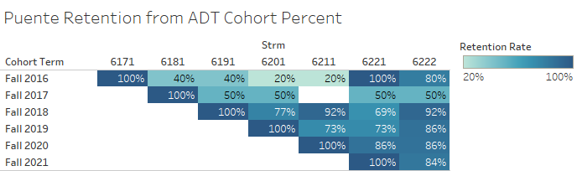

Slide 26
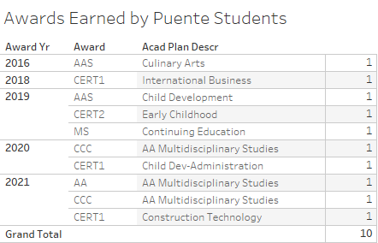

Slide 27
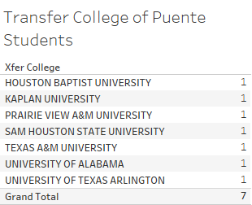

Slide 28
Let’s Talk
Expected Outcome
Understand the Bridge (Puente) Program framework
How the topic relates to Student Success
How the topic is connected to Equity and Equity-Mindedness
Results that show evidence of success/equitable outcomes
Directions: Please get into groups of 3, Select a Recorder, Speaker, and Answer the following questions.
After going through the data, what questions do you have?
Is this a Program that you believe can be expanded into your area?
5 minutes

Slide 29
5 minutes

Slide 30
Conclusion
Bridge (Puente) Program is closing gaps
Bridge (Puente) Program student success is higher than non-Bridge students

Slide 31
Thank you!

