Slide 1

Coleman College for HEALTH SCIENCEs
Dental Assisting Program

Slide 2
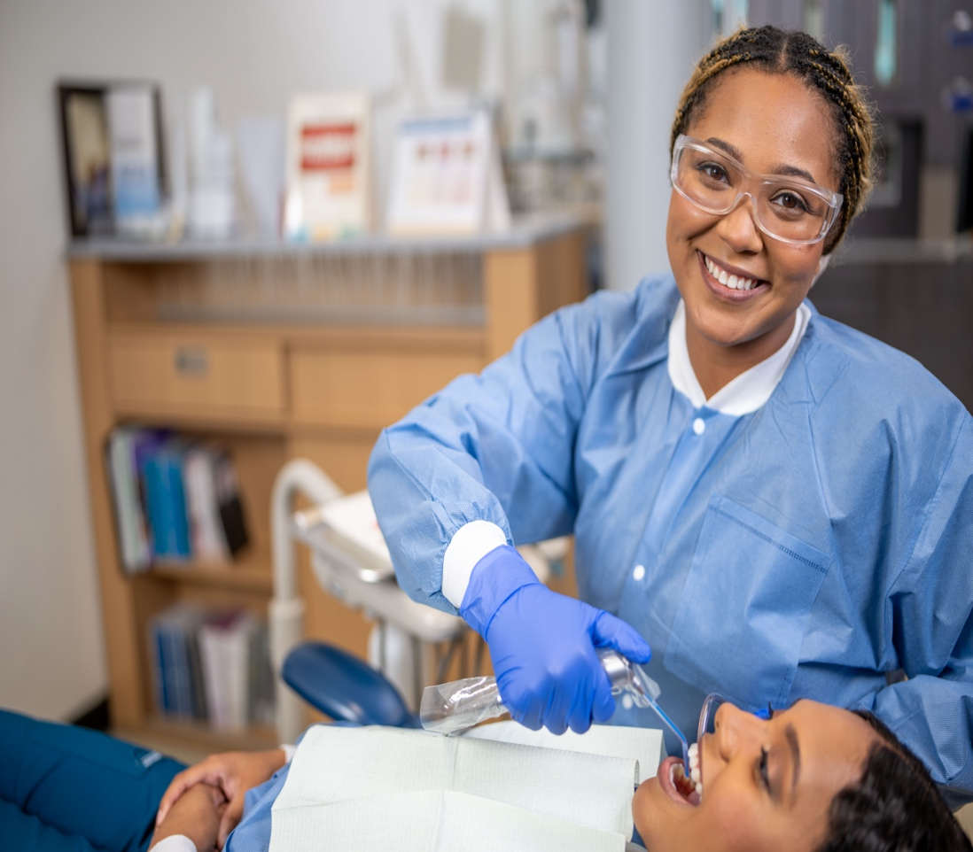
Overview
Dental Assistants work under the supervision of a licensed dentist and assist in the care and treatment of dental patients. They perform a variety of important functions in the dental office. As a vital member of the dental health team, the dental assistant prepares the patient for treatment, provides the dentist with necessary instruments, instructs patients in proper oral hygiene, records dental services, and performs various laboratory procedures and managerial duties for the office.

Slide 3

Admission Steps
Apply to HCC to get a student ID
1.
2.
Apply to the Dental Assisting Program
3.
Must be a high school graduate or have a GED
4.
GPA of at least a 2.0 – no prerequisites

Slide 4
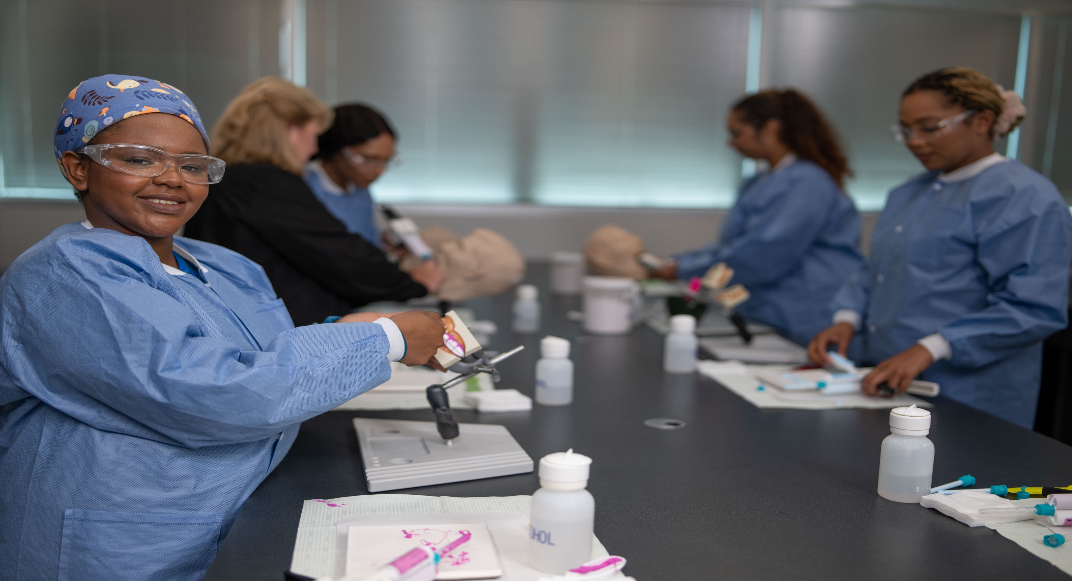
The only program in the greater Houston area accredited by the Commission on Dental Accreditation!
Fall, Spring, and Summer Start Dates
Advanced standing into the Dental Hygiene Program option

Slide 5
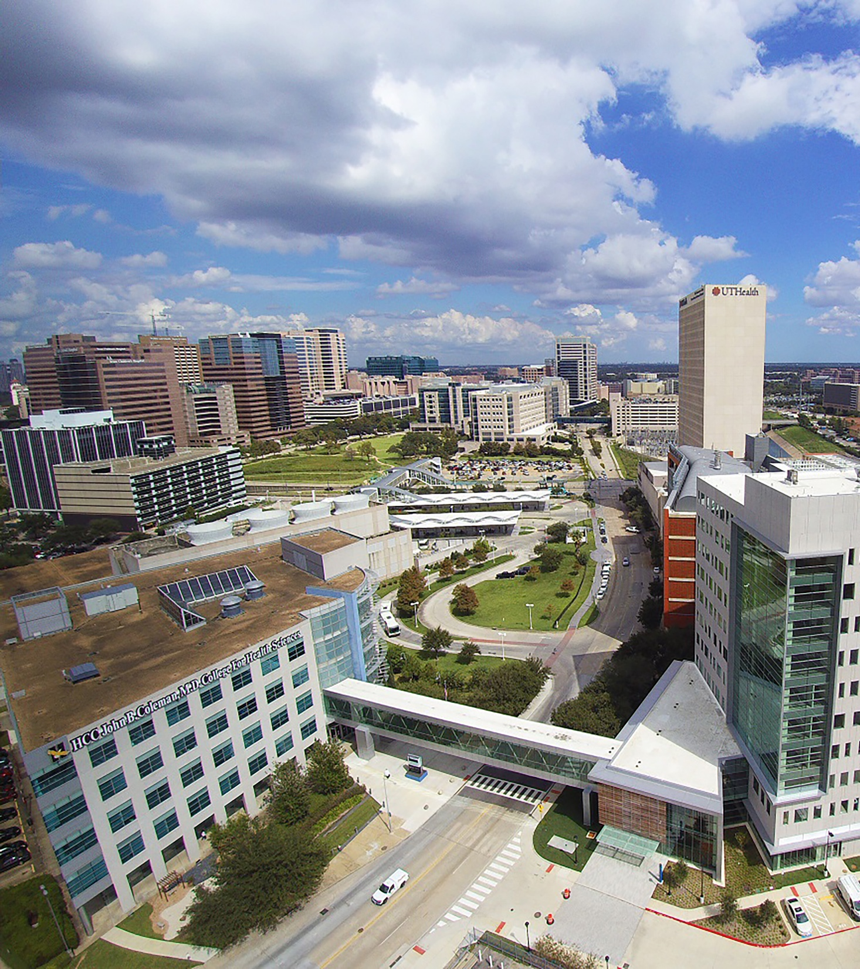
Employment Opportunities
Private Dental Offices
Corporate Dental Offices
Community Clinics
Dental Schools

Slide 6
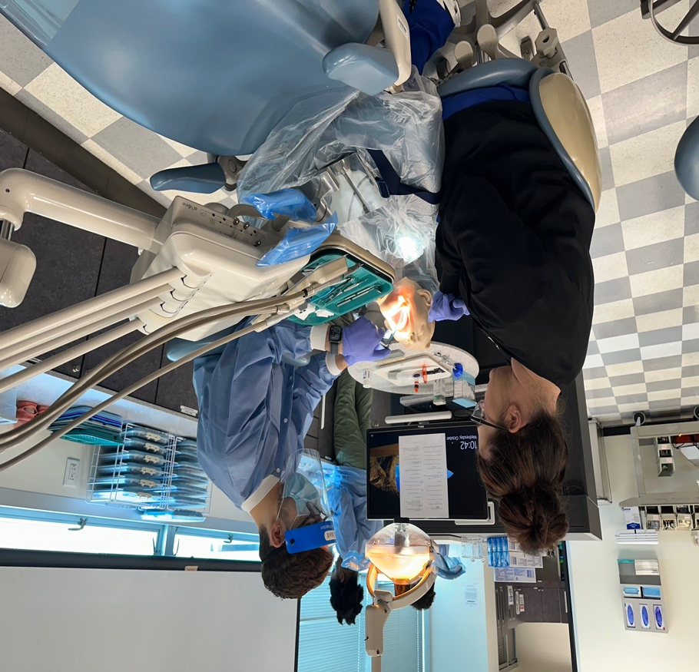
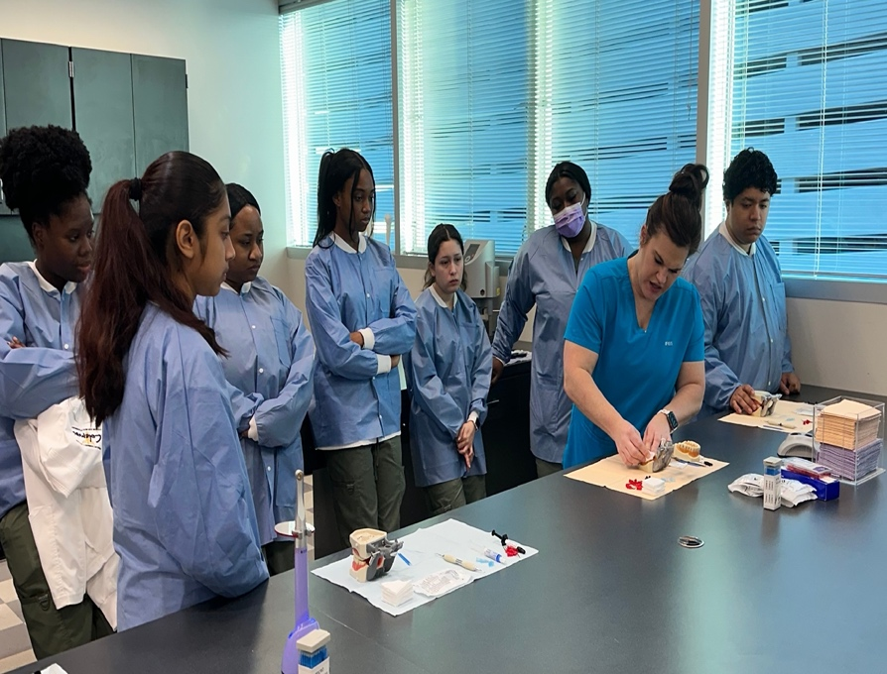
FACE-to-FACE COURSES
DNTA lecture/lab: 8am-4:30pm
DNTA Practicums: Clinic Hours
PROGRAM DURATION
1 Years (39 credit hours)
3 semesters full-time
ADMISSIONS REQUIREMENTS
TSI needed for associates degree
HPRS 1304 taken along with the program

Slide 7
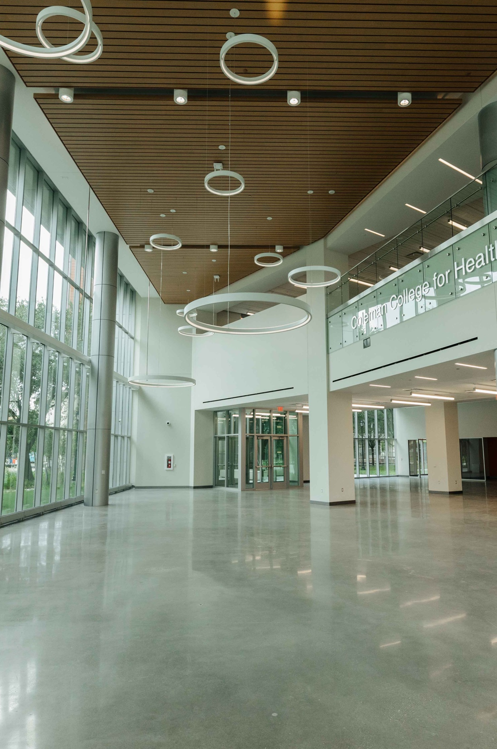
Certificate Degree Plan
Year One
1st Semester
HPRS 1304 Basic Health Professions Skills
DNTA 1305 Dental Radiology
DNTA 1401 Dental Materials
DNTA 1411 Dental Science
DNTA 1415 Chairside Assisting
2nd Semester
DNTA 1245 Preventive Dentistry
DNTA 1349 Dental Radiology in the Clinic
DNTA 1453 Dental Assisting Applications
DNTA 1447 Advanced Dental Science

Slide 8

Degree Plan – Year One
3rd Semester
DNTA 2130 Seminar for the Dental Assistant
DNTA 2367 Practicum (or Field Experience) - Dental
Assistant
DNTA 1102 Communication and Behavior in the Dental Office

Slide 9
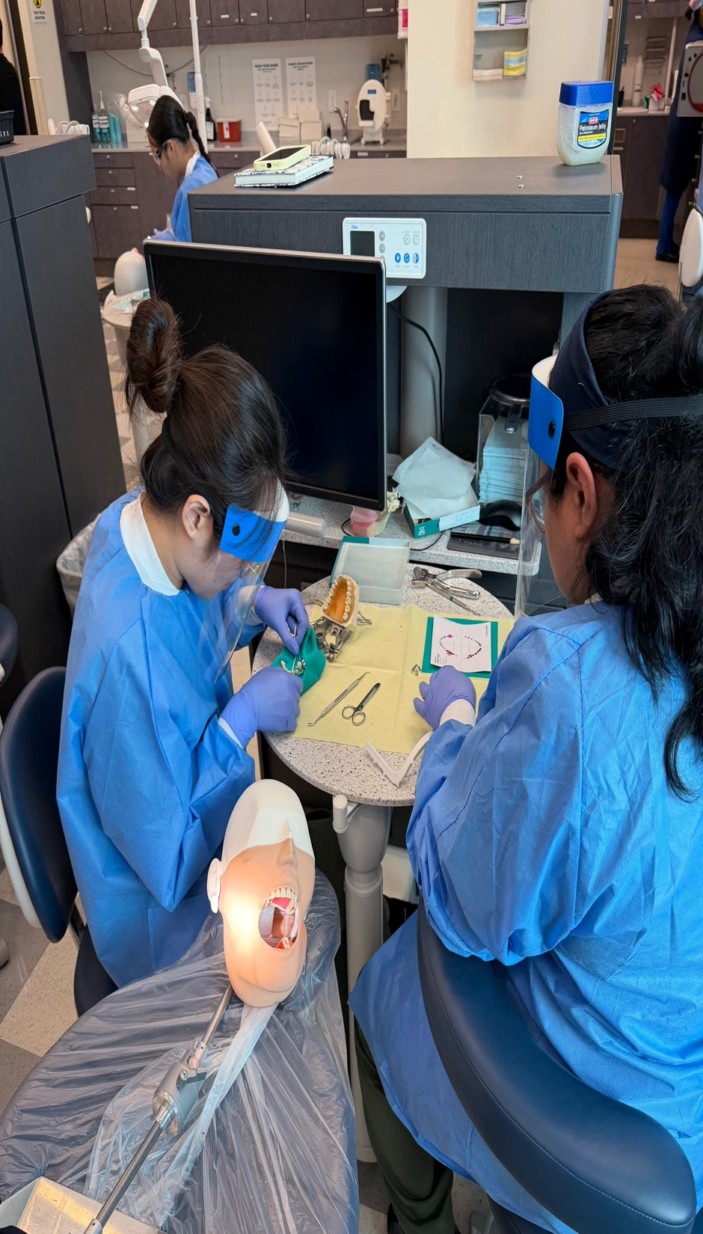
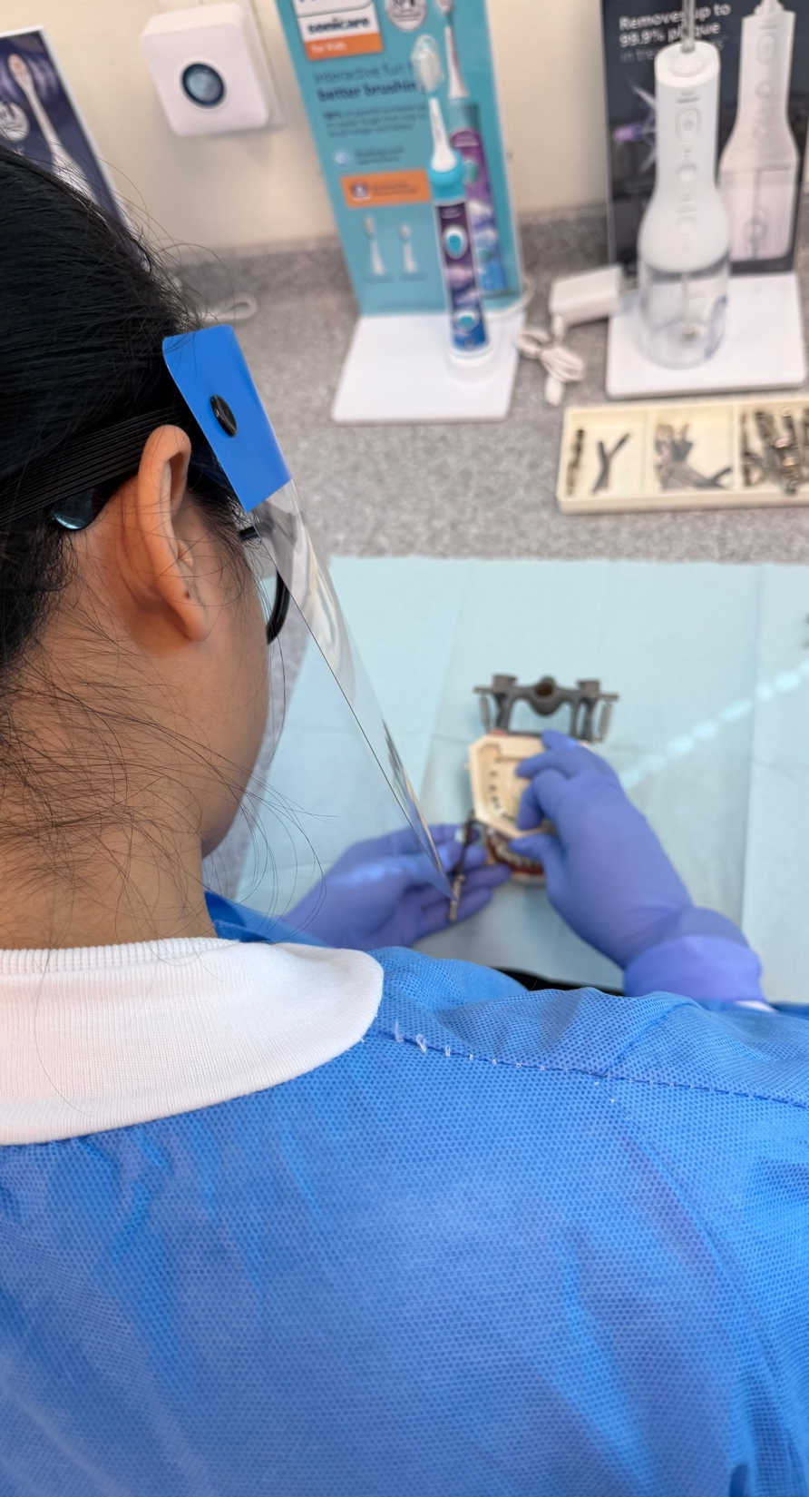
Program Requirements
Clear Background Check
& Drug Screen
Physical Exam
Dental Exam and Cleaning
Immunizations – Shot Record or Titers Showing Immunity
  Hep B Series – (May Take 6 Months for Series)
  MMR – 2 Shots
  Tdap – Within 10 Years
  TB – Within 6 Months
  Varicella – 2 Shots

Slide 10
Program Costs*
*ALL COSTS ARE ESTIMATED AND SUBJECT TO CHANGE
Tuition Costs
Other Costs
In-District: $3,292
Out-of-District: $7,036
Out-of-State: $8,635
$200 Background Check & Drug Screen
(Includes Complio immunization tracker)
$300 Physical/Immunizations
$90 Trajecys
$300 Student Kit
$1400 Instructional Materials
$200 - $300 Uniforms (Scrubs)
(varies) Parking

Slide 11
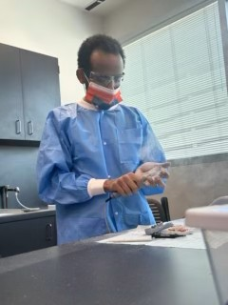

SIMULATION CENTER
Manage $∙$ Assess $∙$Debrief
Training Manikins
Cutting edge patient simulators (including adults, children, maternity and infants), task trainers, learning modules, and mixed reality solutions, offer safe and effective training opportunities for healthcare students across nearly all clinical specialties.
Anatomage Table & Tablets
This advanced technology offers digitized cadavers, intricate vascular systems, 3-D anatomy details can be visualized up to 0.5mm, real patient cases and simulation of real-tissue physiology. Simulation tools include cardiac motions, kinesiology, ocular motions, general pathways, dental arch, and pregnancy & delivery.
Body Interact
Speak naturally with AI virtual patients, asking your own questions. Interactive models dynamically respond to learners’ decisions. Observe real-time adjustments of vital signs, symptom progression and organ function.

Slide 12
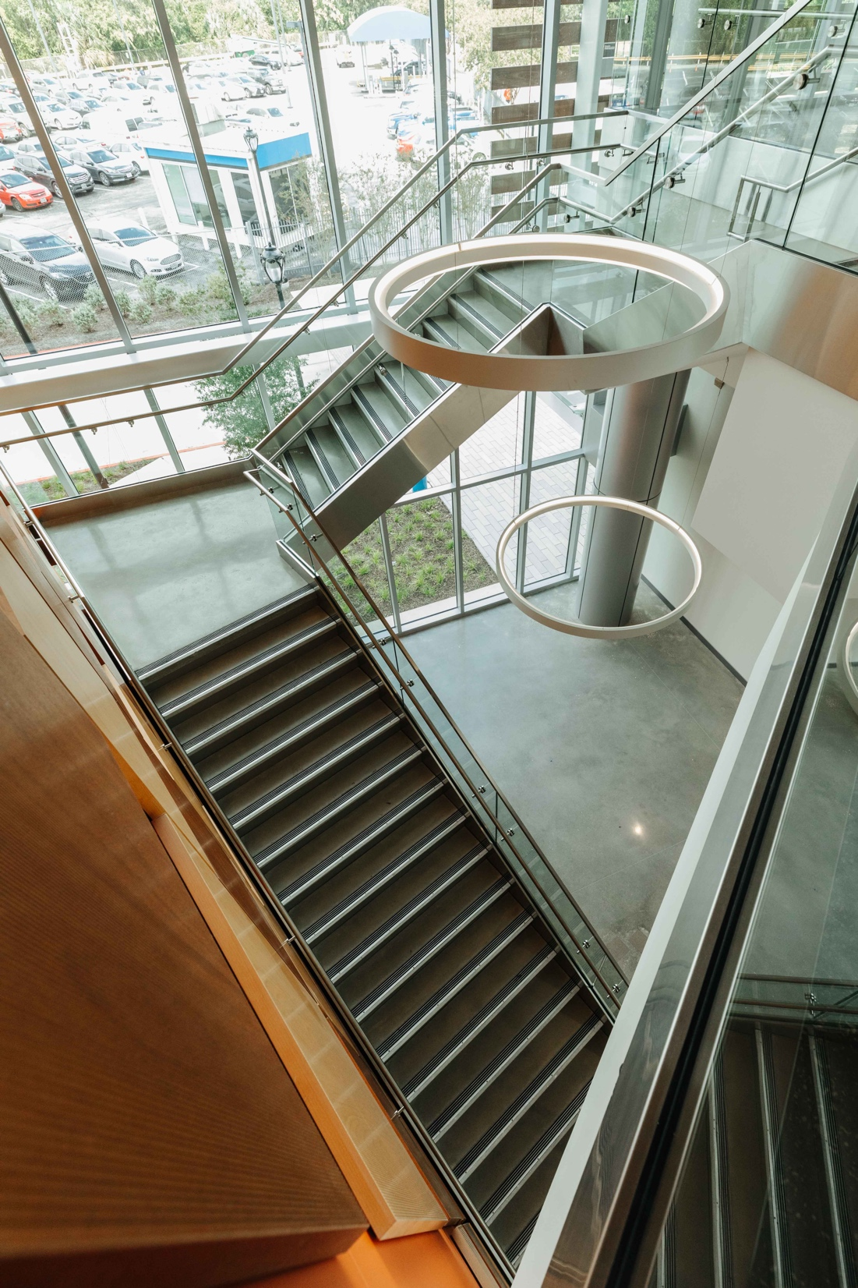
The credit hours you have earned in a Dental Assisting (AAS) degree can be applied towards HCC’s Bachelor of Applied Science (BAS) in Healthcare Management.
Pathway After Graduation
Your Journey Doesn’t End Here!

Slide 13
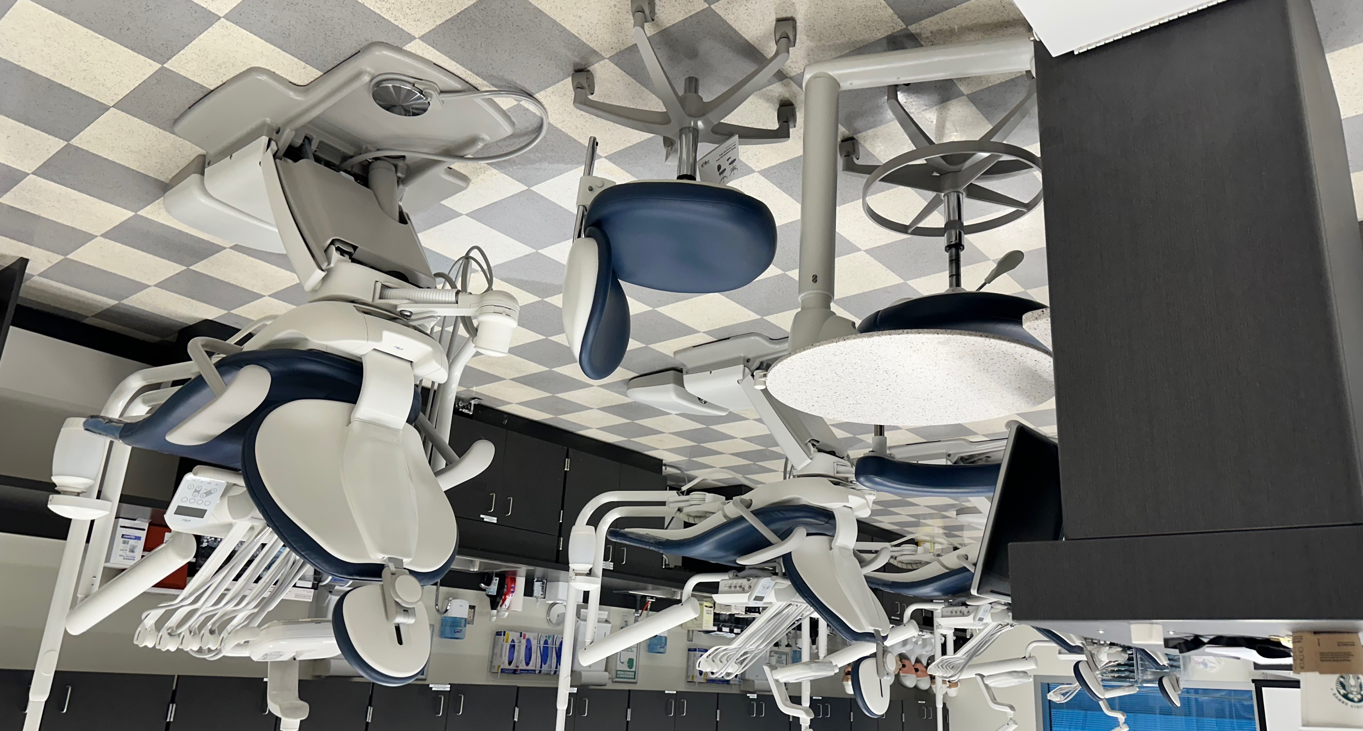
Program Accreditation
The ONLY school in the greater Houston area that is accredited by the Commission on Dental Accreditation.
The Commission is a specialized accrediting body recognized by the United States Department of Education.
Advanced standing into the Dental Hygiene Program

Slide 14
Contact Us
Dental Assisting
WEBSITE
www.hccs.edu/health
ADVISING
(713) 718-7082
Yolanda Colbert
coleman.advising@hccs.edu
GENERAL QUESTIONS
(713) 718-5940
co.dentalassisting@hccs.edu
PROGRAM DIRECTOR
(713)718- 7351
Kay Jukes
Kay.jukes@hccs.edu

Slide 15
Thank You!
Please click HERE to confirm you have completed the PowerPoint.

