Slide 1
Student Success Metrics
Dr. Andrea Burridge
Associate Vice Chancellor
Research, Analytics, Decision Support
2/10/2022

Slide 2
Houston GPS: Time to Degree

Slide 3
Houston GPS Outcome Data – First Time in College, Time to Degree, by Award Year
Source: Houston GPS Data

Slide 4
Students Earning Zero Hours

Slide 5
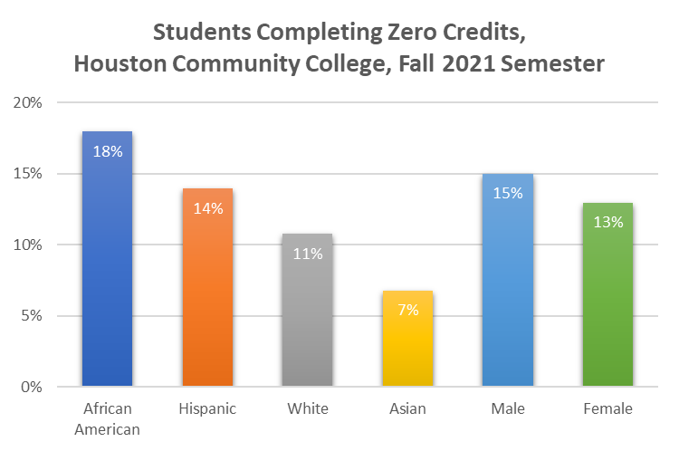
Includes all students enrolled in SCH coursework, Fall 2021
Source: HCC DataMart Files, Fall 2021 EOT

Slide 6
Students Earning Zero Credit Hours, Fall 2021 vs. Fall 2022
Source: HCC DataMart Files, Fall 2021 and Fall 2022 EOT

Slide 7
Students Earning Zero Credit Hours, Fall 2021 New Students vs. Overall
Source: HCC DataMart Files, Fall 2021 EOT

Slide 8
Students Earning Zero Credit Hours, Fall 2022, by FT/PT and Dual Credit
Source: HCC DataMart Files, Fall 2022 EOT

Slide 9
Discussion

Slide 10
47%
of students are the first in their family to attend college
Trellis COVID basic needs and mental health, 2022
Photo: HCC Trio Program

Slide 11
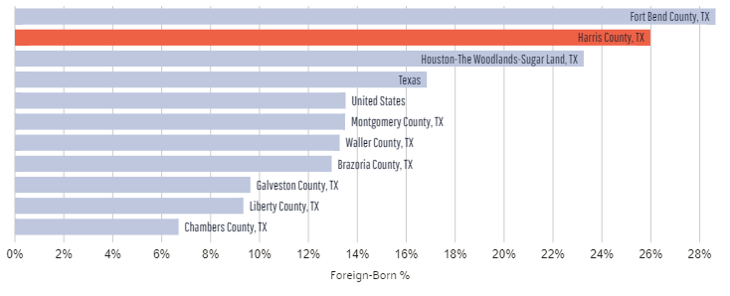
Percent of Foreign-Born Residents, Gulf Coast Counties (2020 ACS)
35%
of students’ first language is not English
CCSSE 2022, item 41
Focus Group funded by Greater Texas Foundation
Graph from Harris County, TX | Data USA

Slide 12
“It’s taking me longer because I [have to] consider my work schedule … I didn’t get any grants this semester so it’s all loans. If I go to work at 5 AM, I don’t want to be grumpy and tired where I don’t want to go to class. You always want to strive for an A. But that really is the main barrier, is trying to make sure I have the time to do it.
--HCC Student
74%
of students work in addition their schoolwork while they are at HCC
CCSSE 2022, item 10b
Focus Group funded by Greater Texas Foundation

Slide 13
35%
of students are primary caregivers to children who live with them
64%
of students are spend time caring for dependents in a typical week
Trellis Basic Needs and Mental Health (COVID-19) Survey
Explore Our Policy & Advocacy Agenda — Generation Hope

Slide 14
80%
of students experience one or more types of basic needs insecurity
More than 3 in 5
students experience food insecurity
74%
of students show signs of housing insecurity
Trellis COVID basic needs and mental health, 2022

Slide 15
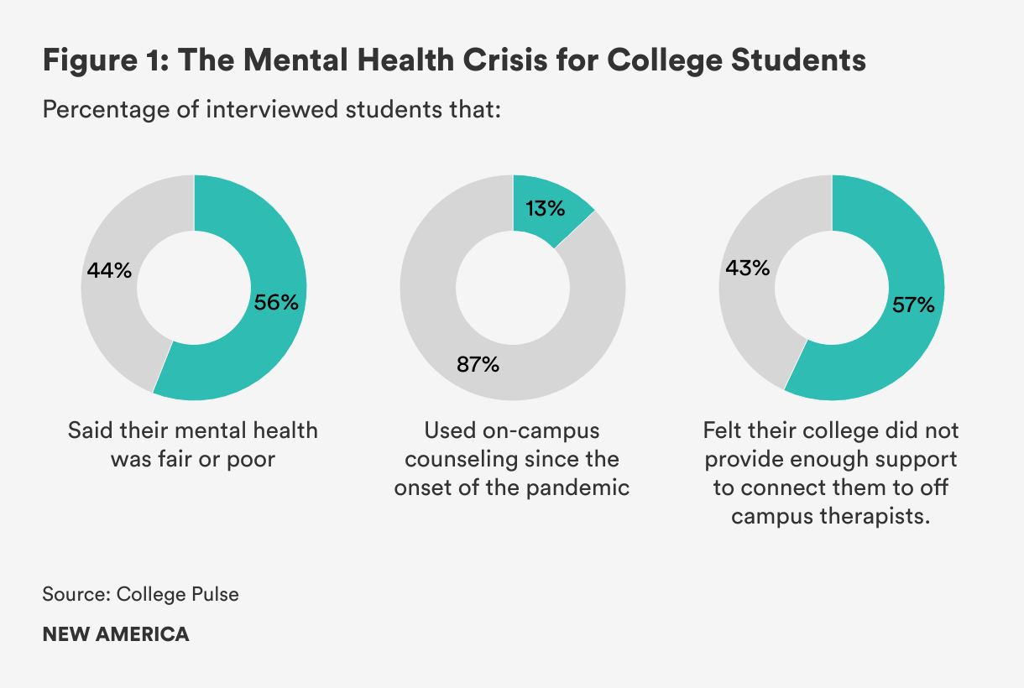
46%
report facing mental health challenges post-COVID
Nationally
Trellis COVID basic needs and mental health, 2022

Slide 16
Fall to Fall Persistence: Second Fall and Third Fall

Slide 17
AtD Cohort, Fall to Fall Persistence (Persistence to Second Fall)
Source: HCC CPI/KPI Dataset, as of 1/10/2023

Slide 18
Fall to Fall Persistence, Award, Transfer, HCC Achieving the Dream Entering Cohorts, 2016 to 2021
Source: AtD Cohort Data. As of 1/12/2023
* The three-year window extends through Summer, 2023 for this group
Notes:
This chart shows our three-year transfer rates by race/ethnicity. We see differences institutional transfer outcomes by race and ethnicity, but recently increased rates for African American and Hispanic students. In fact, the increase on the previous slide is primarily due to the increasing rates of transfer by Black and Hispanic students. Currently, as part of our QEP, Personalized Learning Pathways, as students enter HCC, we are working to have important conversations about career goals and transfer, increasing the support students receive to prepare them to meet their future goals.

Slide 19
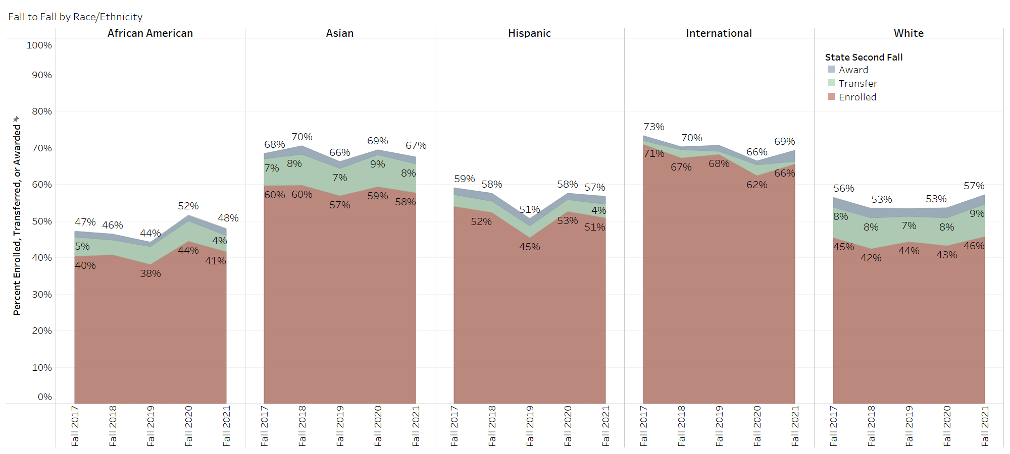
Fall to Fall Persistence, Award, Transfer, HCC Achieving the Dream Entering Cohorts, 2016 to 2021
Source: HCC CPI/KPI Dataset, as of 1/10/2023

Slide 20
Fall to Fall Persistence, Award, Transfer, HCC Achieving the Dream Entering Cohorts, 2016 to 2021
Source: HCC CPI/KPI Dataset, as of 1/10/2023

Slide 21
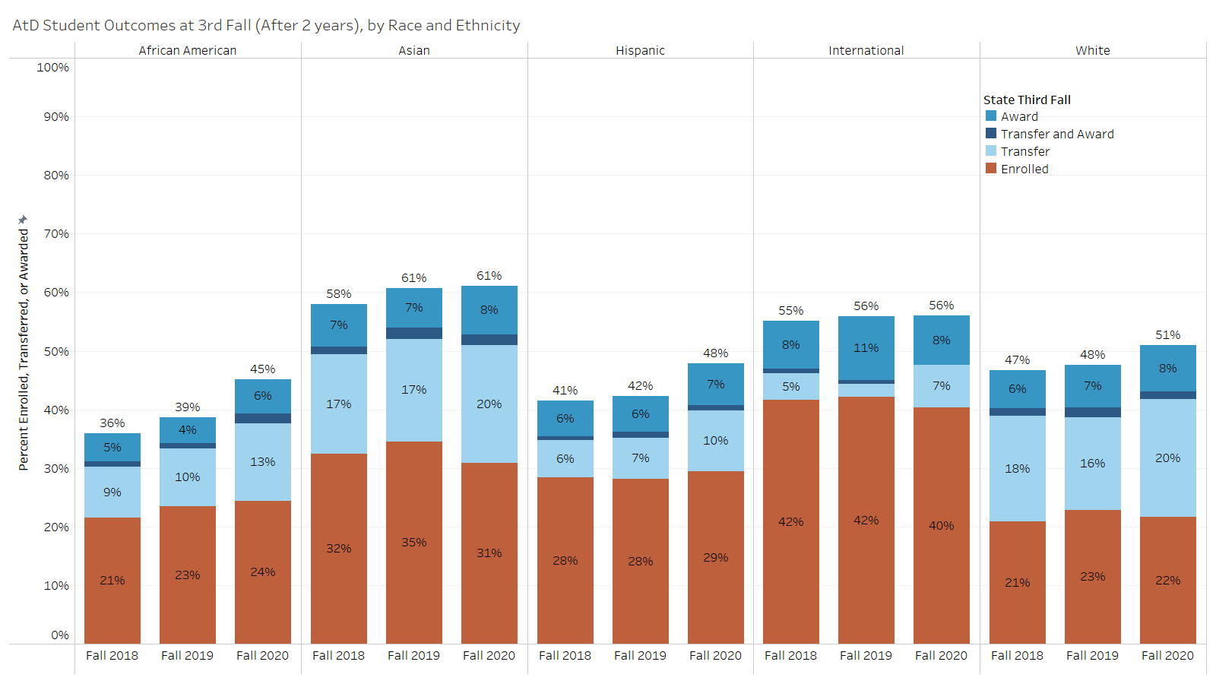
Source: HCC CPI/KPI Dataset, as of 1/10/2023

Slide 22
Transfer

Slide 23
Overall Transfer Rate, HCC Achieving the Dream Entering Cohorts. Transfer within Three Years of Entry
Source: AtD Cohort Data. As of 1/12/2023
* The three-year window extends through Summer, 2023 for this group
Notes:
Previously I’ve shown you data indicating that approximately 2/3 of HCC students indicated that they plan to transfer to a four year institution. This is an important goal for our students, and we work with four-year institutions to build articulation agreements and 2+2 pathways to support our students in meeting their goals. Our three-year transfer rate, which is the proportion of students who successfully transfer within 3 years, is an important measure of success. This graph shows our three-year transfer rate over time, beginning with the students who entered in 2015, through the students who entered Fall 2020, who we are continuing to follow.
We see that the three year transfer rate has been relatively stable over time, including the heart of the COVID pandemic. We see our 3-year transfer rate is increasing, suggesting that our work is facilitating students’ successful transfer.

Slide 24
Transfer Rate, HCC Achieving the Dream Entering Cohorts. Transfer within Three Years of Entry, By Race/Ethnicity
Source: AtD Cohort Data. As of 1/12/2023
* The three-year window extends through Summer, 2023 for this group
Notes:
This chart shows our three-year transfer rates by race/ethnicity. We see differences institutional transfer outcomes by race and ethnicity, but recently increased rates for African American and Hispanic students. In fact, the increase on the previous slide is primarily due to the increasing rates of transfer by Black and Hispanic students. Currently, as part of our QEP, Personalized Learning Pathways, as students enter HCC, we are working to have important conversations about career goals and transfer, increasing the support students receive to prepare them to meet their future goals.

Slide 25
Discussion

