Slide 1
HCC Student Success Summit
FRED A. BONNER II, Ed.D.
Professor and Endowed Chair, Department of Leadership and Counseling
Founding Executive Director, Minority Achievement, Creativity and High Ability (MACH-III) Center
April 24, 2023
West Houston Institute

Slide 2
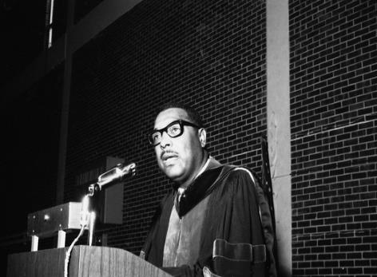
VIDEO -The Scratch Line
“As a people we still have tremendous societal deficits to overcome, particularly among marginalized youth without hope, but I believe the glass is more than half full.”
…from The Substance of Things Hoped For: A Memoir of African-American Faith
Rev. Dr. Samuel Dewitt Proctor

Slide 3
Introduction
Institutions in the twentieth century have had to deal with difficult challenges regarding multiculturalism.
Most mission statements emphasize students, teaching, community service, and diversity as priority issues, yet these values do not appear reflective of their practice (Watson, 1998).

Slide 4
HOW MINORITY STUDENTS EXPERIENCE COLLEGE

Slide 5
Introduction
Today, institutions of higher education are coming to the realization that they are inadequately prepared to understand the learning and developmental needs of racial, cultural, and linguistic minorities.

Slide 6
Introduction
The specific aim of this research is twofold: (1) to characterize the range of students’ out-of-classroom learning experiences, and (2) to identify institutional factors that promote their out-of-classroom learning and personal development.
Notes:
Astin: Involvement refers to the investment of physical and psychological energy in various objects.Regardless of the object, involvement occurs along a continuum. Involvement has both quantitative and qualitative features. The amount of student learning and personal development associated with any educational program is directly proportional to the quality and quantity of student involvement in the program. The effectiveness of any policy or practice is directly related to how it increases involvement.

Slide 7
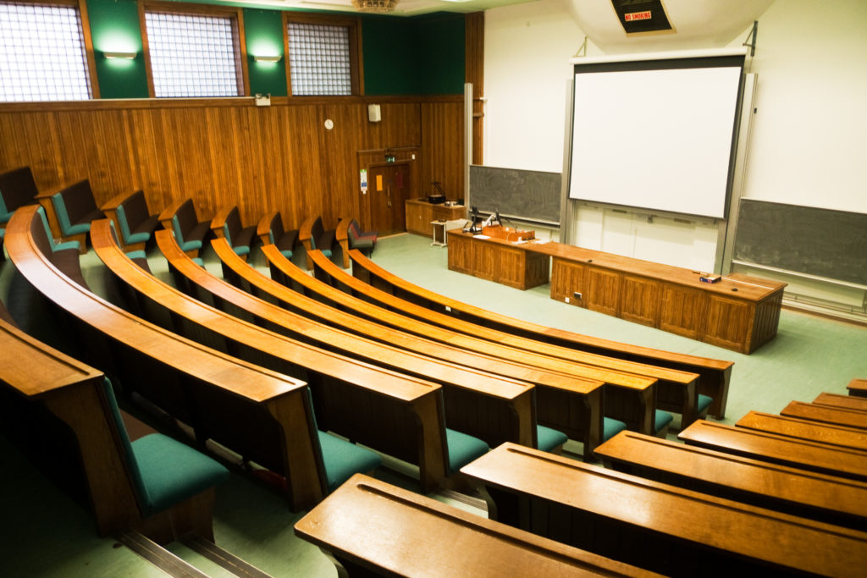
Introduction: The Questions
How do undergraduate students of color experience out-of-classroom learning?
How do they characterize such experiences?
Notes:
The beauty and challenge of this investigation was to answer these questions from a viewpoint not well understood in behavior research—through the eyes of the students themselves.

Slide 8
Introduction
Utilizing qualitative research techniques such as focus groups, structured interviews, and document analysis, the research team collected an array of data about the experiences of minority students at small, predominantly White liberal arts institutions.
Our goal was to ascertain the most significant commonalities among institutions with predominantly White student populations that have maintained high retention rates for minority students.

Slide 9
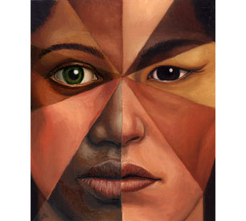
Introduction: The Questions
How does racial identity influence students of color and their out-of-classroom learning?

Slide 10
Introduction: The Questions
How does campus institutional climate influence the out-of-classroom learning for students of color?

Slide 11
Introduction: The Significance
Expands the understanding about minorities’ out-of-classroom learning experiences and their personal development by emphasizing non-cognitive success measures
Utilizes the advantages of qualitative research to record minority student’s own voices in ways quantitative research cannot do.

Slide 12
Introduction: The Significance
--Offers innovations as to how culture-specific and multicultural programs should occur within academic and student affairs
--Determines the means by which students of color perceive their place in the environment of predominantly White colleges and the means by which they adjust to the culture of these institutions.

Slide 13
Introduction
As the population of our country rapidly becomes more diverse, faculty and administrators in higher education must be prepared to meet students’ educational and cultural needs on a broader basis than ever before.
Discovering how best to educate racial and cultural minorities while expanding White students’ awareness of multiculturalism are challenges facing colleges and universities.

Slide 14
Defining Multiculturalism
Accordingly, “a multicultural organization is one that is genuinely committed to diverse representation of its membership; is sensitive to maintaining an open, supportive and responsive environment; is working toward and purposefully including elements of diverse cultures in its ongoing operations; and…is authentic in its response to issues confronting it” (Strong, 1988, p. 85).
Multicultural education is an idea or concept, an educational reform movement, and a process (Banks, 2016)
Notes:
Cross (1991) talks about stages…monocultural, coexisting as separate cultures, true multiculturalism…
BREAK HERE! (Activity) Six categories emerged from our investigation…a category is a unit of meaning derived from a careful analysis of the qualitative data…basically, six overarching themes relating to How Minority Students Experience College Emerged…See if you can come up with six, take your best guess, we will reveal in part II, during our discussion, each of the categories and we will see how well you performed…work in teams, using the colored paper as group designations, remain in these groups for part II for interactive dialogue…

Slide 15
Six Philosophical Assumptions
#1 - Multicultural students proceed through a definable set of developmental phases as they progress throughout the college years
#2 - Multicultural students learn and grow best when they are involved in their campus communities, and that involvement is valued by the institution.

Slide 16
Six Philosophical Assumptions
#3 - Multicultural students learn and develop in a variety of ways within and outside the formal classroom setting.
#4 - Multicultural students interact with their campus environments in ways that encourage their personal development and promote their learning.

Slide 17
Six Philosophical Assumptions
#5 – Campus climate has a direct impact on multicultural students’ experiences in college and how they thrive in their learning communities.
#6 – Multicultural students change colleges in significant and positive ways that enhance the entire campus community.

Slide 18
The Categories
What you see is what you get. (reality of campus culture)
Ask anyone—they’ll tell you. (perceptions of campus and its mission)
So where’s the professor? (lack of faculty diversity and involvement)
If I can make it there, I can make it anywhere. (coping statements and self-beliefs)
R-e-s-p-e-c-t: Find out what it means to me. (campus perceptions of students)
If this world were mine…(involvement, future views of self)
Notes:
Cross (Nigrescence)…Pre-encounter, Encounter, Immersion-Emersion, Internalization, Internalization-Commitment.
Phinney (Ethnic Identity): Diffusion-Foreclosure, Moratorium, Identity Achievement

Slide 19
What You See is What You Get. (Reality of Campus Culture).
The expectations and preconceived notions of students of color about their college agents, peers, and campus environment are not in sync with their experienced reality.
Hurn (1993) and Bourdieu and Passeron (1977) view education as an important social and political force in the process of class reproduction.

Slide 20
Ask Anyone—They’ll Tell You. (Perceptions of Campus and Its Mission
Minority students often lament their role as spokesperson for their racial and ethnic groups, a role they are invariably expected to play in non-minority settings.
Students often imply that their dual role as a minority student and as a college student significantly impacts their identity and development (Roebuck & Murty, 1993).

Slide 21
So Where’s the Professor? (Lack of Faculty Diversity and Involvement)
Probably the most significant element influencing the performance level of many students is their inability to connect to an institutional agent.
According to Allen (1986), relationships with faculty for minority students, African American students in particular, are one of the most effective predictors of student outcomes.

Slide 22
If I can make it there, I can make it anywhere. (coping statements and self-beliefs)
Dorsey and Jackson (1995) found that despite minority students’ levels of academic satisfaction and achievement, a substantial percentage reported feelings of socio-cultural isolation in terms of the campus environment.
Paul (1988) found that minority student expectations regarding future life success is deeply rooted in experiences within nonminority contexts.

Slide 23
R-e-s-p-e-c-t: Find out what it means to me. (campus perceptions of students)
To create campus environments that promote a sense of respect for all student populations, institutions must employ broad-based initiatives that address the interests, motivations, and nuances indigenous to each cultural and ethnic group.
Notes:
Roebuck and Murty (1993) report on the problematic interpersonal relationships, personal identity, and Black consciousness issues on campus (predominantly White).

Slide 24
If this world were mine…(involvement, future views of self)
An institutional environment can be studied from a number of different perspectives—physical, human aggregate, organizational, and perceptual (Moos, 1985).
Creating campus environments that are conducive to student attraction, satisfaction, and stability requires a certain synergistic effort on the part of student populations and campus officials (Gordon & Strode, 1992).

Slide 25
Conclusion
How do undergraduate students of color experience out-of-classroom learning? How do they characterize such experiences?
How does racial identity influence students of color and their out-of-classroom learning?
How does campus institutional climate influence the out-of-classroom learning for students of color?

Slide 26
Do they struggle to BELONG in College?

Slide 27
Context Defined
C=P₁*P₂*S
C=Context
P₁=People
P₂=Place
S=Situation

Slide 28
Lewin’s Interactionist Paradigm
B=f(P*E)
B=Behavior
f=function
P=People
E=Environment

Slide 29
DEI(B)

Slide 30
Belonging: Where do we begin?
Belonging differs based on students’ social identities, such as race, gender, sexual orientation, or the conditions they encounter on campus.

Slide 31
Defining Belonging
Hurtado and Carter's (1997) sense of belonging measure focused on students' attachment to the campus community as a whole while other researchers focused on attachment to various external communities or other university contexts (Hoffman, Richmond, Morrow, & Salomone, 2002; Kember & Leung, 2004; Lee & Davis, 2000).
Hurtado and Carter (1997) explain that “sense of belonging contains both cognitive and affective elements in that the individual’s cognitive evaluation of his or her role in relation to the group results in an affective response” (p. 328)

Slide 32
Defining Belonging
According to Strayhorn (2012), sense of belonging “refers to students’ perceived social support on campus, a feeling or sensation of connectedness, the experience of mattering or feeling cared about, accepted, respected, valued by, and important to the group (e.g., campus community) or others on campus (e.g., faculty, peers)” (p. 3).

Slide 33
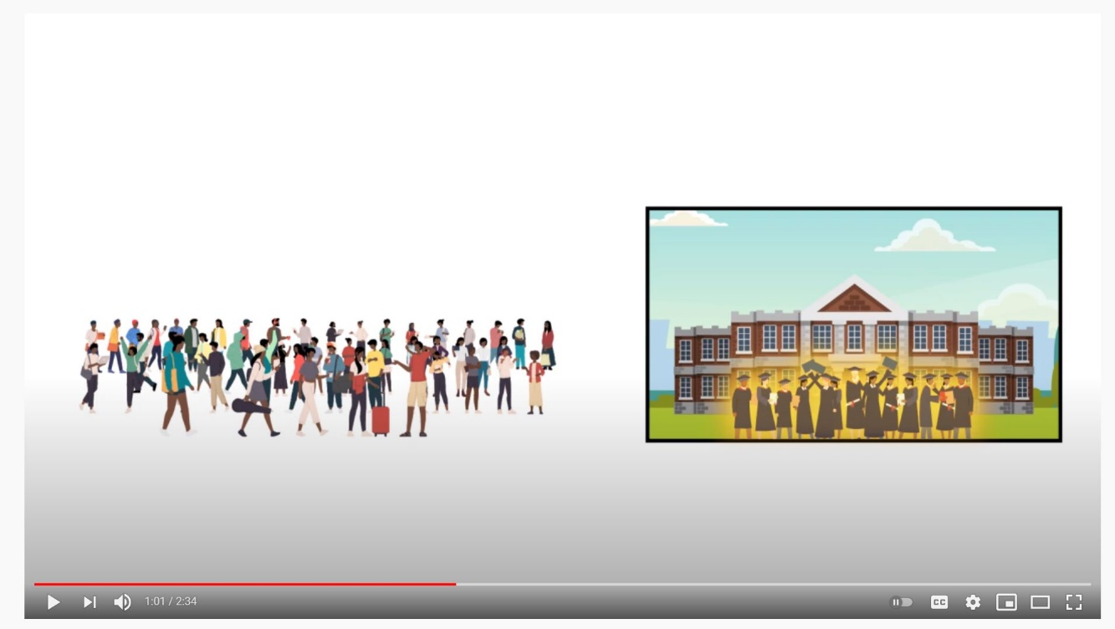
VIDEO - Belongingness Theory in Universities
Belongingness Theory in Universities

Slide 34
Activity: Conceptually Clustered Matrix Diversity, Equity, Inclusion & Belonging
 | Diversity | Equity | Inclusion | Belonging
Students
Faculty
Staff
Alumni
Community Partners
Administration (Leadership)

Slide 35
BREAKOUT SESSION: Understanding Microaggressions
https://video.ucdavis.edu/media/What+are+MicroaggressionsF/1_sukv7tbn

Slide 36
BREAKOUT SESSION: Understanding Microaggressions
While early theorizing focused solely on racial microaggressions, microaggressions can be expressed toward any marginalized group in our society. They can be linked to racism, sexism, genderism, heterosexism, classism, ableism, and other forms of oppression. (Nadal, Whitman, Davis, Erazo, & Davidoff; 2016; D.W. Sue & Capodilupo, 2008).

Slide 37
BREAKOUT SESSION: Understanding Microaggressions
What are Microaggressions?
Coined by African American psychiatrist and Harvard University professor Chester Middlebrook Pierce in his work with Black Americans.
He defined microaggressions as ‘subtle, stunning, often automatic, and nonverbal exchanges which are ‘put downs’ (Pierce, Carew, Pierce-Gonzalez, & Willis, 1978).

Slide 38
BREAKOUT SESSION: Understanding Microaggressions
First, in this case, ‘micro’ does not refer to being small or innocuous but rather underscores the interpersonal, microlevel context of the act. Microaggressions denote an interpersonal interaction involving a perpetrator and a target (marginalized group member).
Second, we must keep in mind the term ‘aggression”—verbal or nonverbal behavior intended to harm (Sue, 2020, p. 7).

Slide 39
BREAKOUT SESSION: Understanding Microaggressions
Thus, microaggressions are verbal and nonverbal interpersonal exchanges in which a perpetrator causes harm to a target, whether intended or unintended. These brief and commonplace indignities communicate hostile, derogatory, and/or negative slights to the target (D.W. Sue, Capodilupo, et al., 2007).

Slide 40
BREAKOUT SESSION: Understanding Microaggressions
THREE MAJOR CATEGORIES
MICRO ASSAULTS (e.g. name calling, discriminatory acts, flags/symbols)
MICROINSULTS (e.g. ascription of intelligence, ascription of abnormality, ascription of criminality)
MICROINVALIDATIONS (melting pot, I have an ‘X’ friend, nativist bias) (D.W. Sue, 2020)

Slide 41
BREAKOUT SESSION: Understanding Microaggressions
MICROINTERVENTIONS (take aim)
The everyday words or deeds, whether intentional or unintentional, that communicate to targets of microaggressions and macroaggressions (a) validation of their experiential reality, (b) value as a person, (c) affirmation of their racial or group identity, (d) support and encouragement, and (e) reassurance that they are not alone.

Slide 42
BREAKOUT SESSION: Understanding Microaggressions
MICROINTERVENTIONS (take action)
Developing perspicacity.
Disempower the inuendo by naming it.
Undermine the metacommunication.
Challenge the stereotype.
Broaden the ascribed trait to a universal human behavior.
Ask for clarification of a statement or action.
Make the metacommunication explicit by restating/rephrasing the statement.

Slide 43
References/Resources:
7 damaging racial microaggressions you may be guilty of using at work, according to a psychologist (theladders.com)
https://video.ucdavis.edu/media/What+are+MicroaggressionsF/1_sukv7tbn

Slide 44
Code Stitching Model

Slide 45
Sorry to Bother You Clip

Slide 47
Contact Information
Fred A. Bonner II, Ed.D.
Professor and Endowed Chair
Department of Educational Leadership and Counseling
Whitlowe R. Green College of Education
Prairie View A&M University
fabonner@pvamu.edu

