Slide 1

Understanding HCC’s Corequisite Professional Development Series
Facilitator: Desmond Lewis, EdD
Panelists: Helen Graham, EdD
Melinda Mejia, PhD
Shameka Reed, MA
Timor Sever, MS
Amy Tan, PhD
Annie Tsui, MA
Fabian Vega, PhD

Slide 2
Expected Outcomes
• How the topic relates to Student Success
• How the topic is connected to Equity and Equity-Mindedness
• Results that show evidence of success/equitable outcomes

Slide 3
Expected Outcomes
•Understand the components of the professional development framework
•Learn about HCC’s approach in using relevant data to inform decision-making
•Explore student outcomes in co-requisite courses prior to and after professional development framework implementation

Slide 4
Guiding Principles
A. Development of active intersectional engagement to support institutional excellence in teaching and learning
(ENGAGEMENT)
B. Exploration of effective pedagogies to improve delivery and support mechanisms for co-requisite design models
(PEDAGOGY)
C. Promotion of asset-based approaches, purpose-driven practices, data-informed validation, and independent learning to increase student success through intentional models of practice
(STUDENT SUCCESS)
D. Development of responsive and evaluative practices and learning experiences to promote rigor in academic and workforce educational expectations
(RIGOR)
E. Cultivation of equity-minded, innovative, inclusive, and culturally-relevant practices that translate to all sectors of institutional operations
(EQUITY)
F. Integration of programs, services, and feedback mechanisms to develop intentional student-centered practices that promote engagement and retention
(RETENTION)

Slide 5
Faculty and Staff-led Model
Faculty-led faculty development with increased focus on co-requisite professional development is seen as an opportunity to scale student success--starting with gateway courses.
Serve as a Session(s) Facilitator
Develop Session(s) with Instructional Designer

Slide 6
Let’s Talk
Expected Outcome
Understand the components of the professional development framework
How the topic relates to Student Success
How the topic is connected to Equity and Equity-Mindedness
Results that show evidence of success/equitable outcomes
1) There are 6 Topics with individual Guided Principles. Could you tell me why these 6 Topics were selected?
2) How does the Faculty and Staff led Model work?

Slide 7
Approach
Goals
Realities
Options
Way Forward
GROW Model

Slide 8

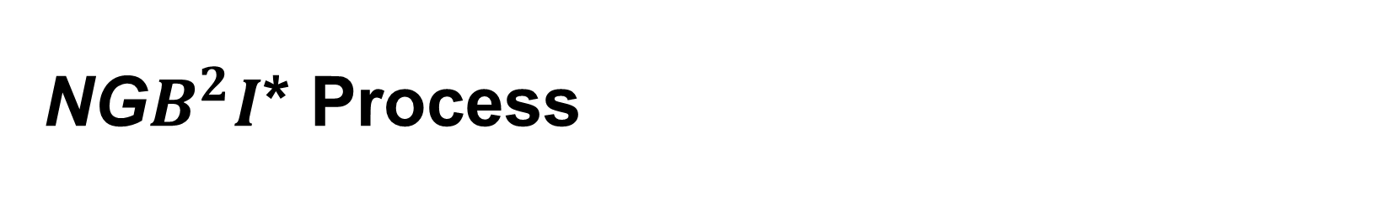
NG$B^{2}I$* Process
Needs
Goals
EFFECTIVE
(Learned)
LESSONS
Barriers
*Source: Adapted from Dr. Allen Goben’s Trust & Empowerment: A Declaration of Interdependence (2016)

Slide 9
6 Annual Sessions Framework
Fall Sessions Spring Sessions
Engagement Rigor
Pedagogy Equity
Student Success Retention

Slide 10
Assigned Session Developers
Each Topic/ Theme will have an assigned Team with a LEAD.
The LEAD is asked to organize meetings, develop a completion date timeline for session(s), and work with assigned team to identify and recruit faculty/staff to facilitate and develop sessions
Provide updates on session progression during COTW meetings
Ensure that session(s) adhere to framework
Identify LinkedIn Learning training(s), Virtual Faculty Lounge training(s), and institutional (departmental/ divisional/ college-wide) professional development opportunities that align with assigned month’s theme that are scheduled for the same month

Slide 11
Session Format
1 hour minimum
Templated (Slide Deck) Structure
2 Break Outs
2 Share Outs
Faculty and/or Staff Led and Designed based on Principle/Category
Virtual Synchronous Modality
Recorded/ Archived
Survey

Slide 12
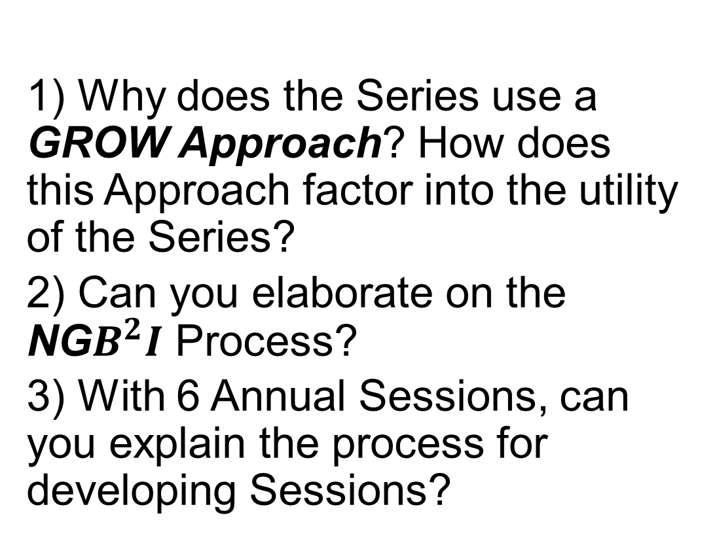
Let’s Talk
Expected Outcome
Understand the components of the professional development framework
1) Why does the Series use a GROW Approach? How does this Approach factor into the utility of the Series?
2) Can you elaborate on the NG$B^{2}I$ Process?
3) With 6 Annual Sessions, can you explain the process for developing Sessions?

Slide 16
Let’s Talk
Expected Outcome
Learn about HCC’s approach in using relevant data to inform decision-making
Expected Outcome
Explore student outcomes in co-requisite courses prior to and after professional development framework implementation
1) What data is recorded from the Sessions?
2) How do you think that the Series has contributed to the increases in success for the corequisite program?
3) Of the 6 Topics of the Series, I know that Equity is one of them. In reflecting on the data from the previous slides, how do you believe that the Equity Session can impact increases for success for traditionally low performing groups?

Slide 17

Corequisite Remediation Process
In Compliance with HB2223 As stated in HB 2223: If a student fails to satisfactorily complete a freshman-level course described by Subsection (c), the institution of higher education shall: review the plan developed for the student under Section 51.335(a) and, if necessary, work with the student to revise the plan; and offer to the student a range of competency-based education programs to assist the student in becoming ready to perform freshman-level academic coursework in the applicable subject area.
Mid Semester Assessment Report
Faculty will identify students who are failing or in jeopardy of failing only.
Faculty will conduct a student conference with each student.
Faculty will complete a Mid-Semester Assessment Report for each student in PeopleSoft (due one week after mid semester).
The Mid-Semester Assessment Report will be automatically emailed to each student.
Student will also receive an invitation to a Mid-Semester Reset Workshop hosted by Advising and attend workshop.
It is the purpose of this Mid-Semester Assessment Report Process to connect with students before they fail. However, for students who fail Coreq courses despite this formal intervention process and/or any other mechanisms already in place, there will be an End of Course Report Process.
End of Course Report
End of Course Report form will be available on People Soft for failing students after grades are submitted.
Faculty will complete the End of Course Report form.
Student will be emailed the End of Course Report form and Individualized Study Plan.
Student will follow up with advisement to go over their Individualized Study Plan.
We are in the stages of testing this plan and need your participation.

Slide 18
COREQUISITE REMEDIATION PROCESS
In Compliance with HB2223
Individual Study Plan
ISP will be available in People Soft for failing students after final grades have been entered and an End of Course (EOC) Report has been completed by faculty.*
ISP is attached to Student’s PeopleSoft Profile, which can be accessed by subsequent corequisite faculty and advisors.
Advisor and student meet and review ISP options and determine next steps.
Student progress is monitored and recorded on ISP by current corequisite faculty.
*Without an EOC Report, no ISP can be generated
Sample Message to the Faculty and Student
Mid-Semester Assessment Report (FacultyEmail)
Dear Lastname, Firstname,
Your Mid-semester Assessment Report for Lastname, Firstname (#########) has been received.
https://sample link
(Student Email)
Dear Firstname,
The following important message was sent to your Message Center and requires your immediate attention:
Mid-Semester Assessment Rpt MATH 0123 CRN 12345
End of Course Report and Individualized Study Plan (Faculty Email)
Dear Lastname, Firstname,
An End of Course Report and Individualized Study Plan for Lastname, Firstname (#########) has been received. This has triggered a notification on their student account Checklist. The student will need to meet with an advisor to review their Individualized Study Plan.

Slide 19
COREQUISITE REMEDIATION PROCESS
In Compliance with HB2223
(Student Email)
Dear Firstname,
The following important message was sent to your Message Center and requires your immediate attention:
End of Course Rpt MATH 13## CRN 12345
Sample Message to the Advisor
End of Course Report and Individualized Study Plan
(This is the 1st communication that gets sent to the Advisor)
Dear Advisor,
An End of Course Report and Individualized Study Plan have been created for your student Lastname, Firstname (#########). This has triggered a notification on their student account Checklist informing them to meet with an advisor to review their Individualized Study Plan. Please meet with your student to review the Individualized Study Plan together and confirm meeting in Advising Notes.
All documents may be accessed using the following link:
https://sample link
Checklist Items:
Trigger or Initial Placement:
There will be a checklist item placed on the student profile for each student when the End of Course Report and ISP are generated. The student will see the Checklist item listed in the two places 1) The Checklist Tile on the Student Home page; it will fall under the category of Other Checklist Item and 2) Student Center as a To Do List Item.
Completion of Checklist:
The completion of the checklist item will be satisfied by two methods. 1) The student will follow the prompts to acknowledge that the student has read the requirements and recommendations made. The checklist completion date will be saved in the system. The checklist will be removed from the student center To-do-list. 2. The student has a conference with an Advisor to discuss the ISP and to register for the recommended course to satisfy the HB.

Slide 20
Let’s Talk
Expected Outcome
Understand the components of the professional development framework
Expected Outcome
Learn about HCC’s approach in using relevant data to inform decision-making
Expected Outcome
Explore student outcomes in co-requisite courses prior to and after professional development framework implementation
1) Please tell me more about the Corequiste Personalized Action Plan (CPAC).
2) Have you seen any changes in corequisite student success since the introduction of the Plan?
3) With an advising component via a Reset Workshop as an integral part of the Plan, please comment the CPAC and its potential impacts as a preventive process for stop outs or failure.

Slide 21
Conclusions:
Corequisite Professional Development is key to building a community of inquiry and practice that leads to sustainable corequisite program improvements
Data is critical for corequisite decision-making
Student Outcomes in corequisite courses require consistent communication among stakeholder (students, faculty, and staff) throughout the student life cycle

Slide 22


